Slide 1

THE PREHISTORIC AEGEAN
Chapter 4
Kleiner, Gardner’s Art through the Ages: A Global History, 16th Edition. © 2020 Cengage. All Rights Reserved. May not be scanned, copied or duplicated, or posted to a publicly accessible website, in whole or in part.

Slide 2
Learning Objectives
Differentiate the formal characteristics of Cycladic, Minoan, and Mycenaean art from those of Egypt, Mesopotamia, and Persia.
List the principal sites and characteristics of Cycladic, Minoan, and Mycenaean art.
Compare and contrast the palatial complexes of the Minoans and the Mycenaeans.
Describe the subjects and techniques of Minoan fresco paintings.
List aspects of prehistoric Aegean art and architecture that preview those of ancient Greece.
Discuss the evidence of intercultural contact among the three Aegean cultures discussed in this chapter, and between the Aegean cultures and ancient Mesopotamian and Egyptian civilizations.
Identify and describe the materials used to create prehistoric Aegean art.
List the differences between Minoan and Mycenaean building materials and techniques.

Slide 3
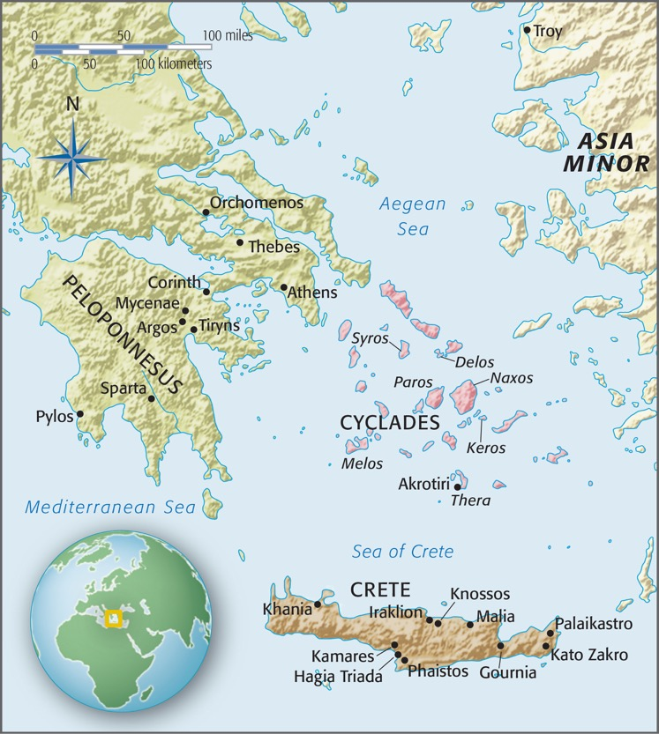
MAP 4.1
4.1 The prehistoric Aegean.

Slide 4
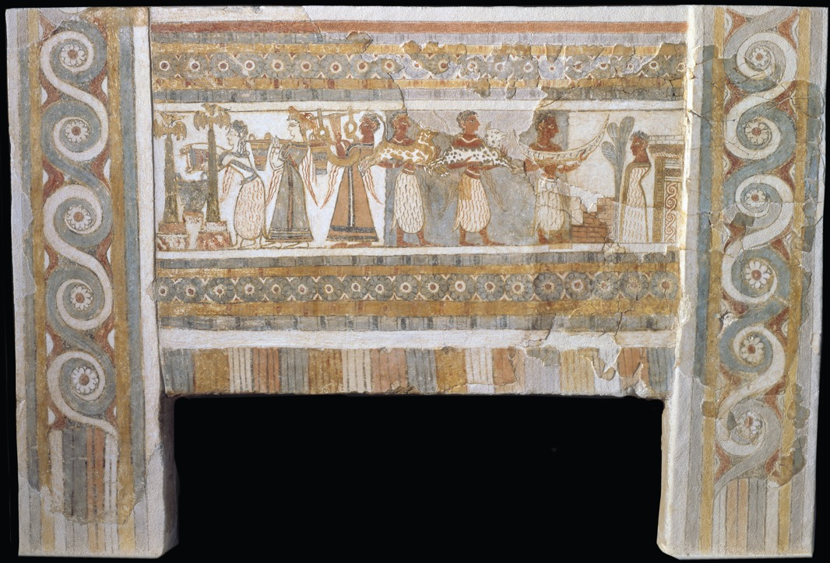
Figure 4.1
4.1 Sarcophagus, from Hagia Triada (Crete), Greece, ca. 1450–1400 bce. Painted limestone, 4' 6" long. Archaeological Museum, Iraklion.

Slide 5
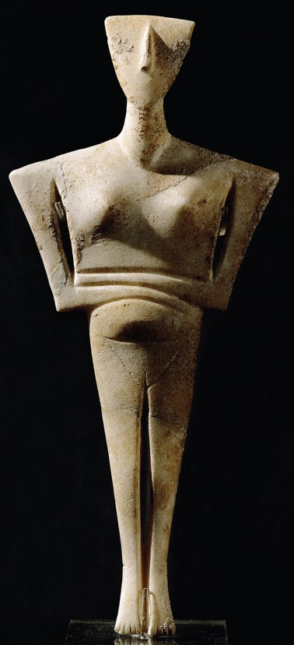
Figure 4.2
4.2 Figurine of a woman, from Syros (Cyclades), Greece, ca. 2600–2300 bce. Marble, 1' 6" high. National Archaeological Museum, Athens.

Slide 6
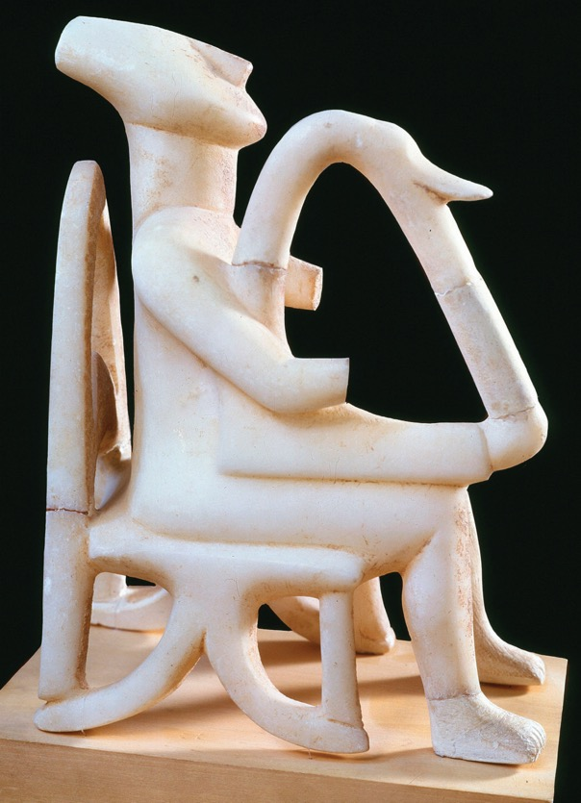
Figure 4.3
4.3 Male harp player, from Keros (Cyclades), Greece, ca. 2600–2300 bce. Marble, 9" high. National Archaeological Museum, Athens.

Slide 7
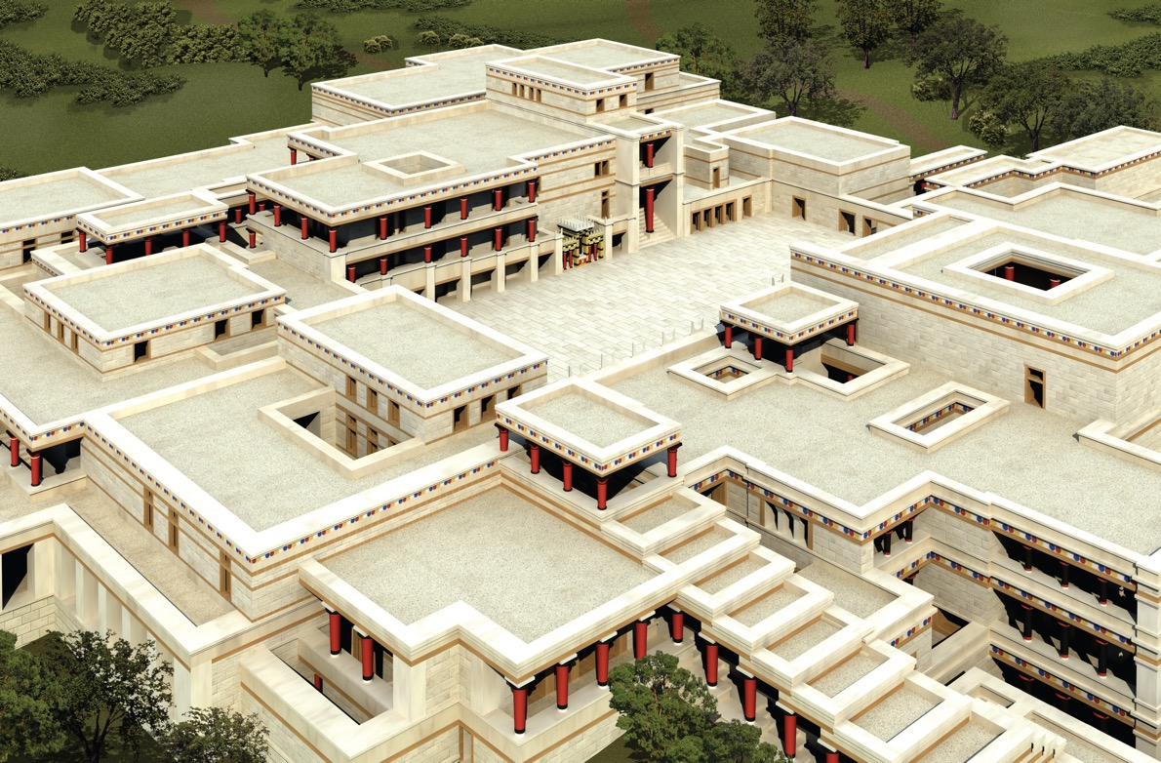
Figure 4.4
4.4 Restored view of the palace (looking northwest), Knossos (Crete), Greece, ca. 1700–1370 bce (John Burge).

Slide 8
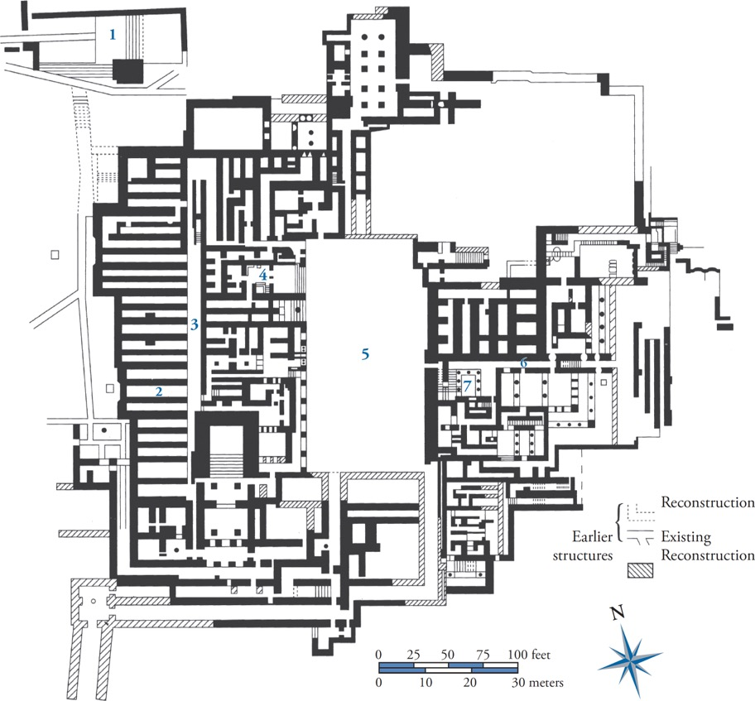
Figure 4.5
4.5 Plan of the palace, Knossos (Crete), Greece, ca. 1700–1370 bce. (1) “theater,” (2) magazines, (3) north-south corridor, (4) throne room, (5) central court, (6) east-west corridor, (7) grand stairwell.

Slide 9
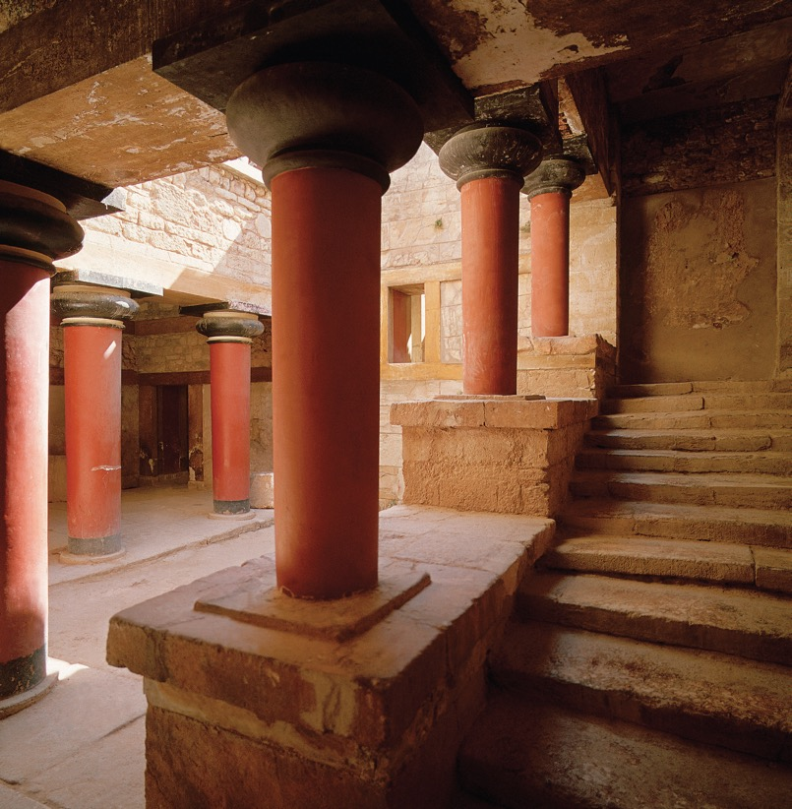
Figure 4.6
4.6 Stairwell in the residential quarter of the palace (fig. 4.5, no. 7), Knossos (Crete), Greece, ca. 1700–1370 bce.

Slide 10
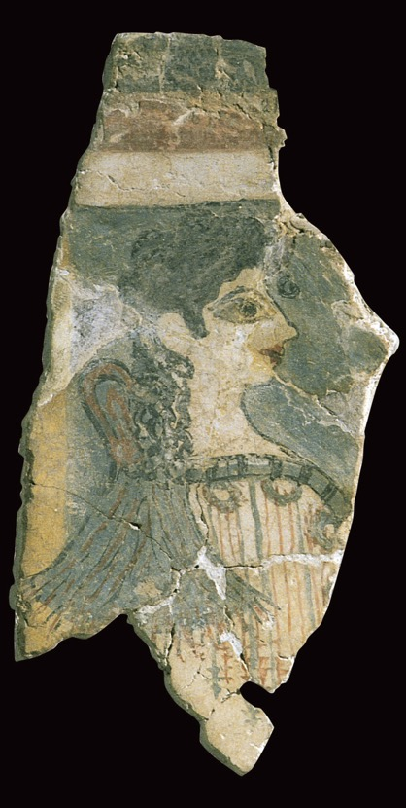
Figure 4.7
4.7 Minoan woman or goddess (La Parisienne), from the palace, Knossos (Crete), Greece, ca. 1500 bce. Fragment of a fresco, 10" high. Archaeological Museum, Iraklion.

Slide 11
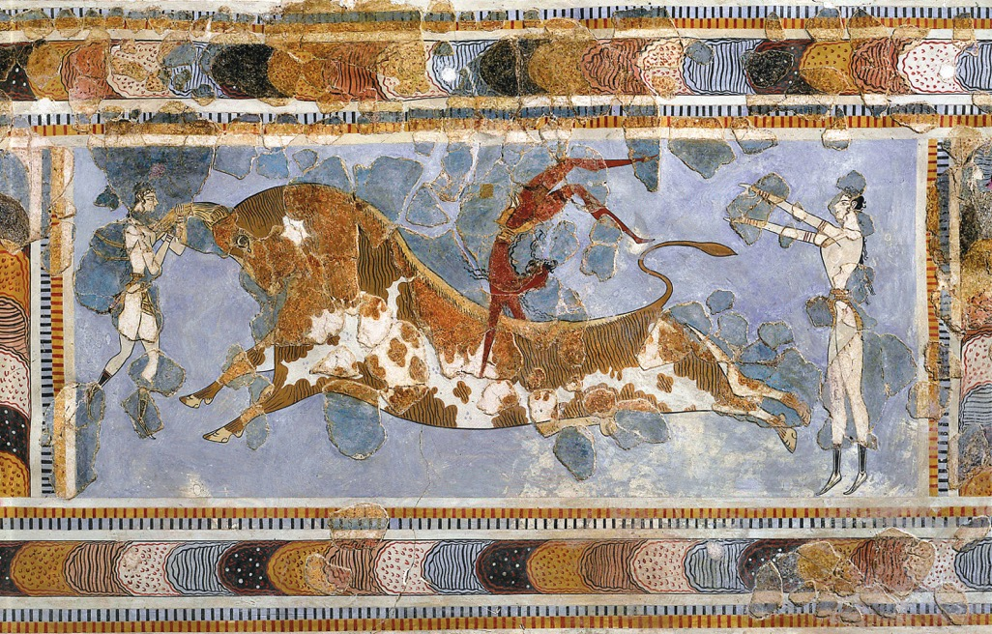
Figure 4.8
4.8 Bull-leaping, from the palace, Knossos (Crete), Greece, ca. 1500 bce. Fresco, 2' 8" high, including border. Archaeological Museum, Iraklion.

Slide 12
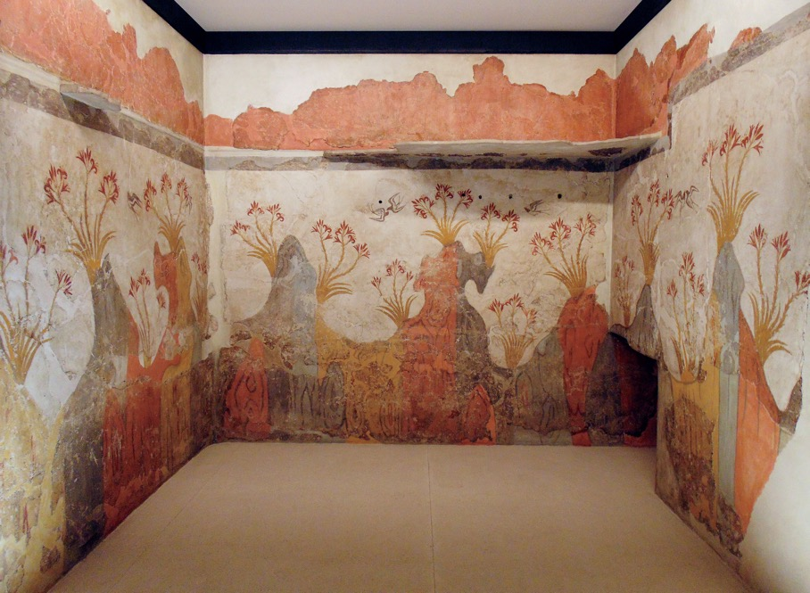
Figure 4.9
4.9 Landscape with swallows (Spring Fresco), south and west walls of room Delta 2, Akrotiri, Thera (Cyclades), Greece, ca. 1650–1625 bce. Fresco, 7' 6" high. Reconstructed in National Archaeological Museum, Athens.

Slide 13
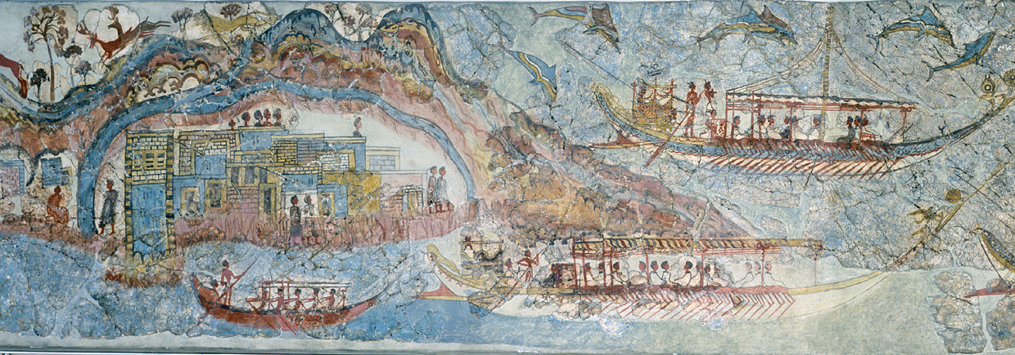
Figure 4.9A
4.9A Flotilla, detail of Miniature Ships Fresco, from room 5, West House, Akrotiri, Thera (Cyclades), Greece, ca. 1650–1625 bce. Fresco, 1' 5" high. National Archaeological Museum, Athens.

Slide 14
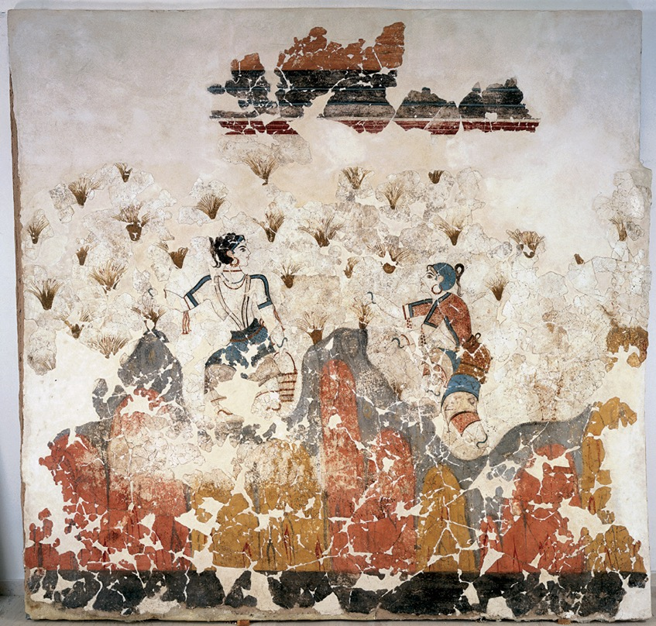
Figure 4.10
4.10 Crocus gatherers, detail of the east wall of room 3 of building Xeste 3, Akrotiri, Thera (Cyclades), Greece, ca. 1650–1625 bce. Fresco, 8' 1/8" high. Reconstructed in National Archaeological Museum, Athens.

Slide 15
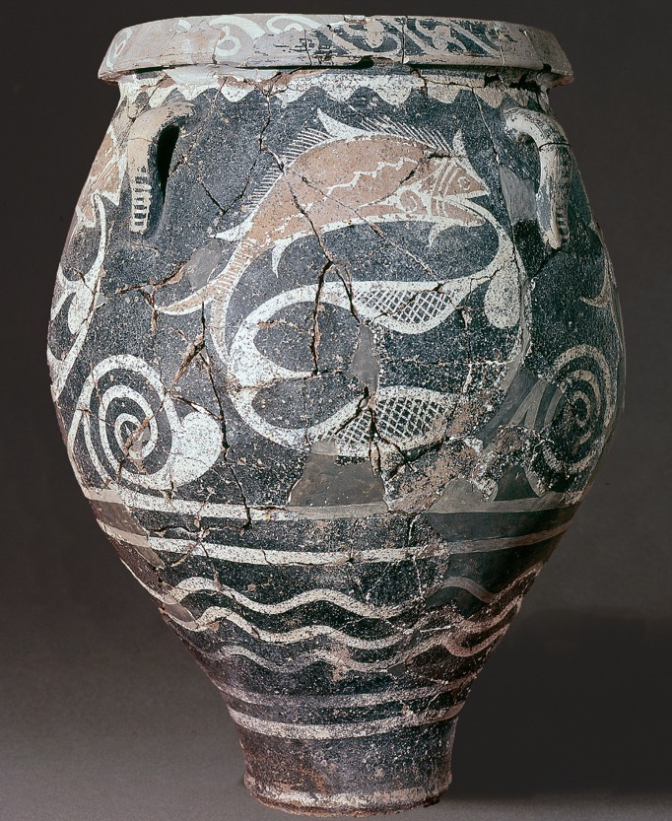
Figure 4.11
4.11 Kamares Ware jar, from Phaistos (Crete), Greece, ca. 1800–1700 bce. 1' 8" high. Archaeological Museum, Iraklion.

Slide 16
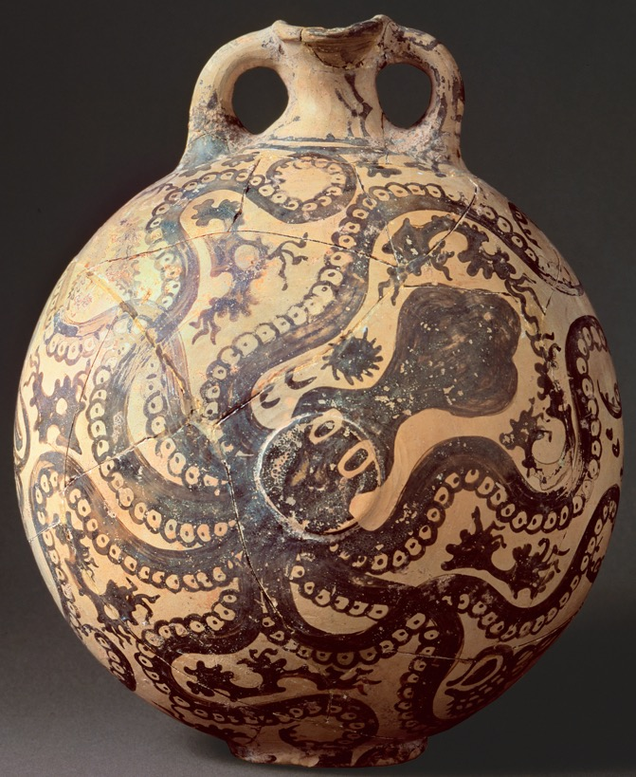
Figure 4.12
4.12 Marine Style octopus flask, from Palaikastro (Crete), Greece, ca. 1500 bce. 11" high. Archaeological Museum, Iraklion.

Slide 17
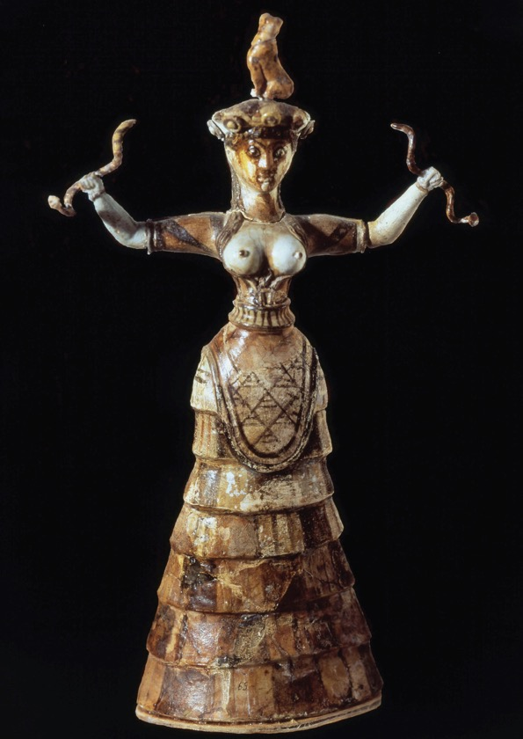
Figure 4.13
4.13 Snake Goddess, from the palace, Knossos (Crete), Greece, ca. 1600 bce. Faience, 1' 1 1/2" high. Archaeological Museum, Iraklion.

Slide 18
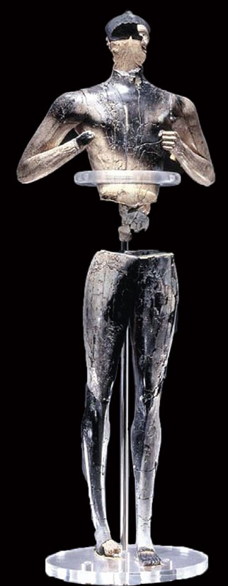
Figure 4.13A
4.13A Young god(?), from Palaikastro (Crete), Greece, ca. 1500–1450 bce. Ivory, gold, serpentine, and rock crystal, restored height 1' 7 1/2". Archaeological Museum, Siteia.

Slide 19
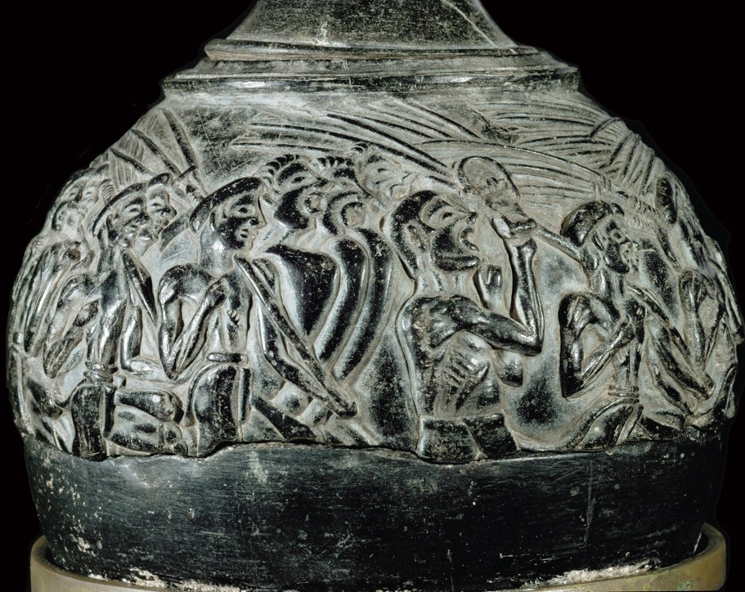
Figure 4.14
4.14 Harvesters Vase, from Hagia Triada (Crete), Greece, ca. 1500 bce. Steatite, originally with gold leaf, greatest diameter 5". Archaeological Museum, Iraklion.

Slide 20
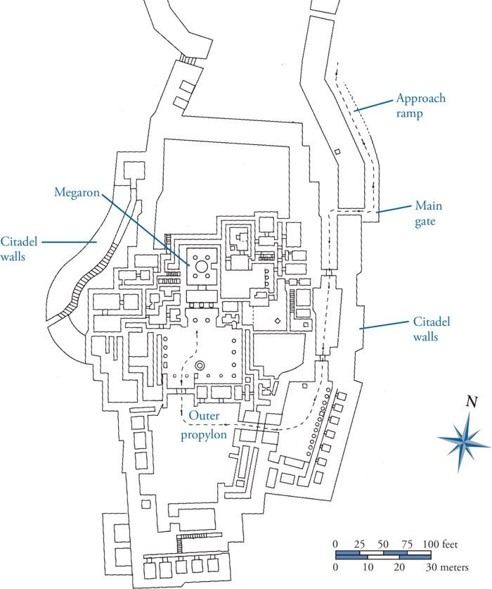
Figure 4.15
4.15 Plan of the palace and southern part of the citadel, Tiryns, Greece, ca. 1400–1200 bce.

Slide 21
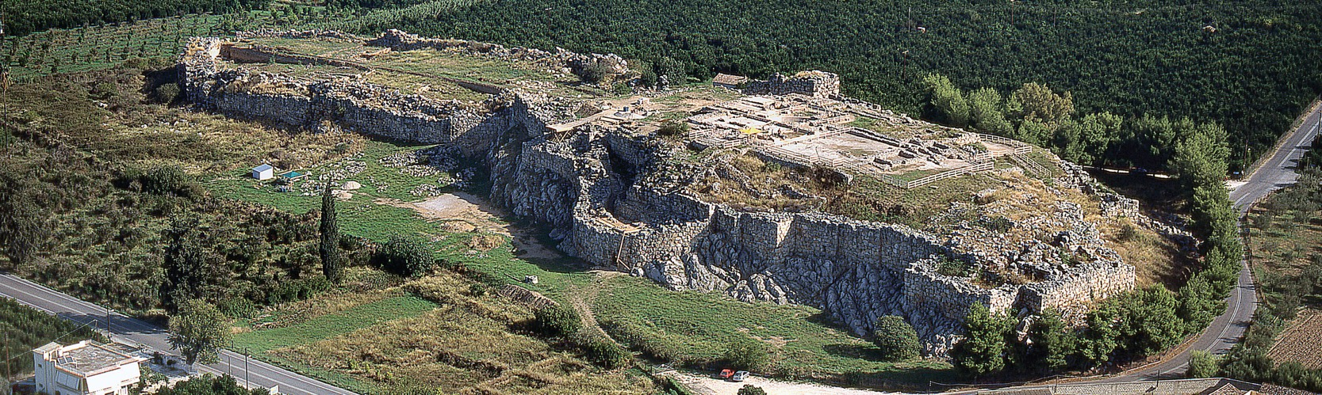
Figure 4.16
4.16 Aerial view of the citadel (looking east), Tiryns, Greece, ca. 1400–1200 bce.

Slide 22
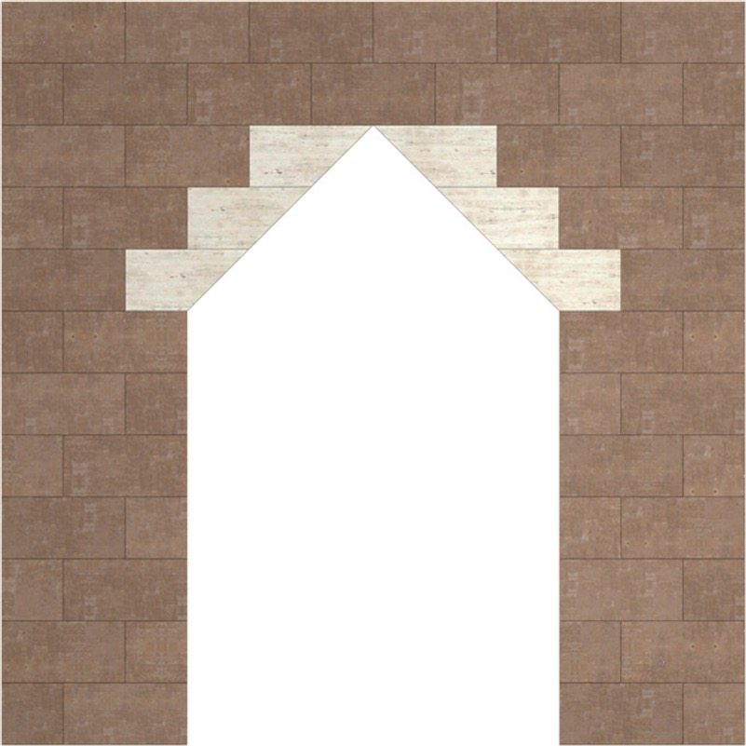
Figure 4.17
4.17 Corbeled-arch construction (John Burge).

Slide 23
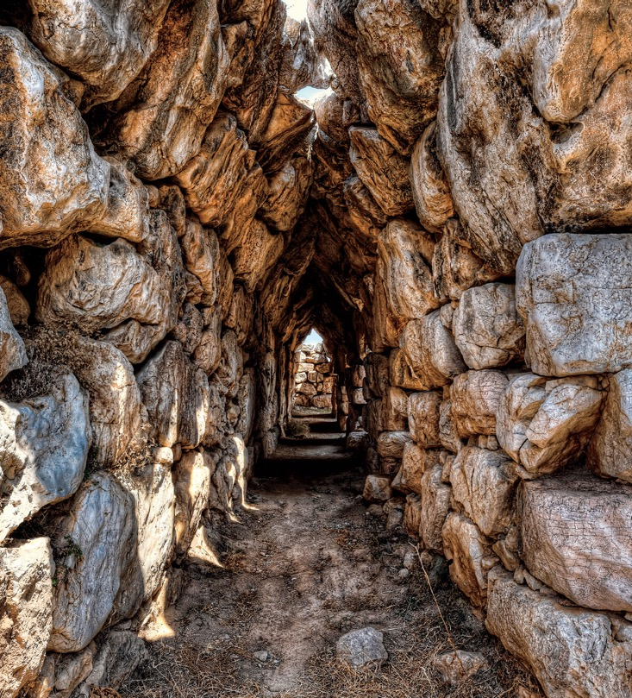
Figure 4.18
4.18 Corbel-vaulted gallery in the circuit wall of the citadel, Tiryns, Greece, ca. 1400–1200 bce.

Slide 24
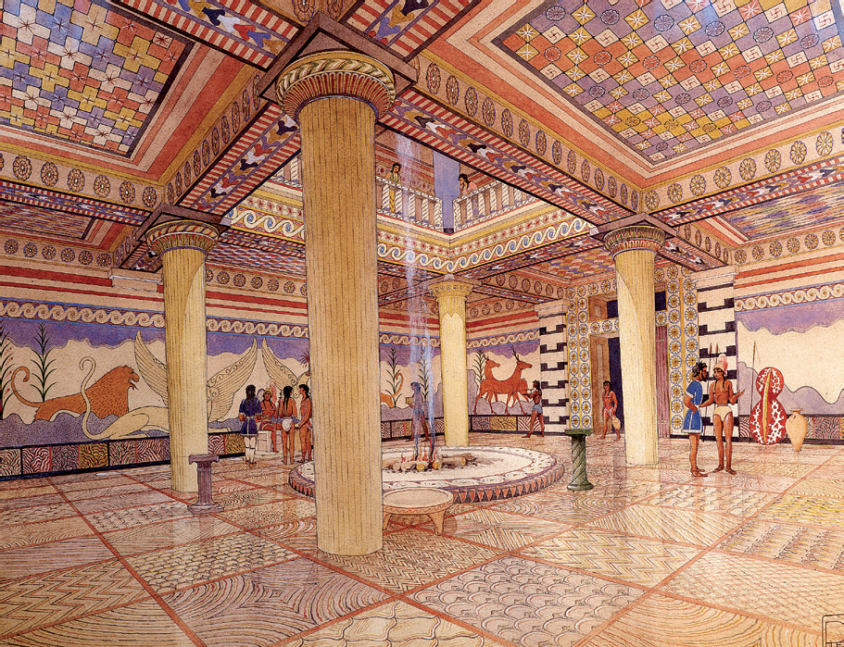
Figure 4.18A
4.18A Restored view of the megaron, Palace of Nestor, Pylos, ca. 1300 bce (watercolor by Piet de Jong).

Slide 25
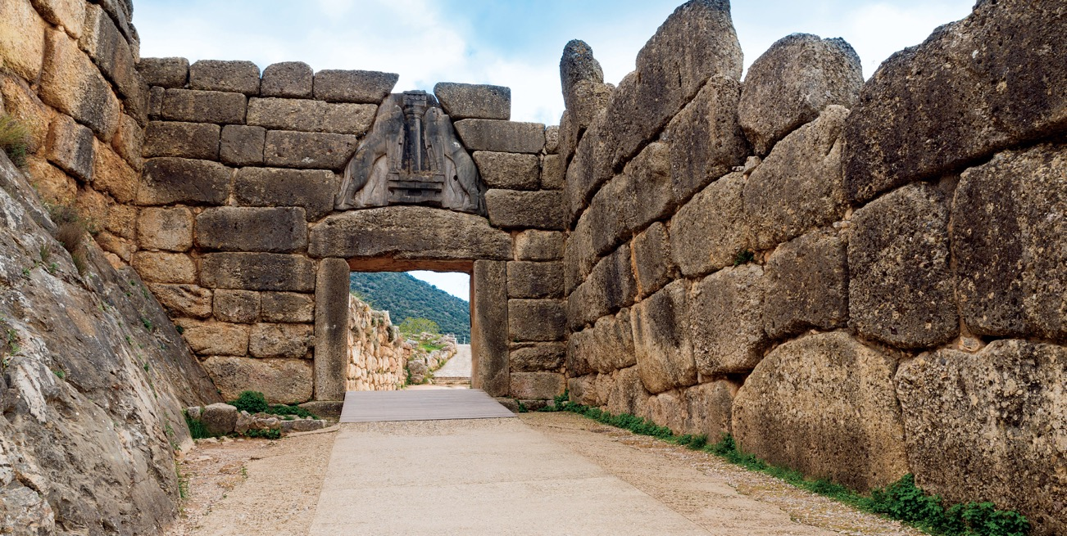
Figure 4.19
4.19 Lion Gate (looking east), Mycenae, Greece, ca. 1300–1250 bce. Limestone, relief panel 9' 6" high.

Slide 26
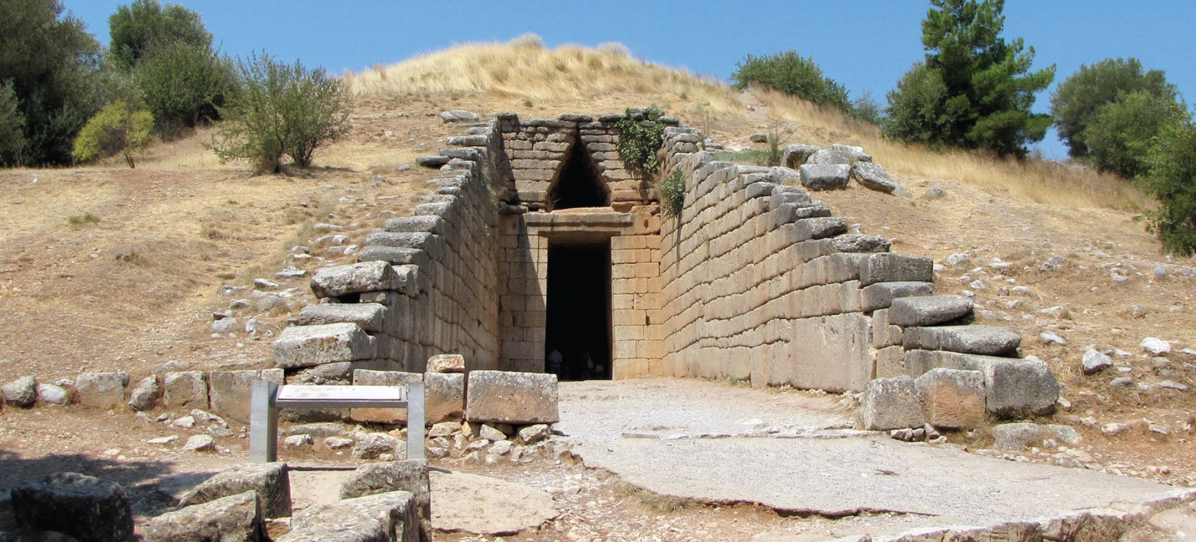
Figure 4.20
4.20 Exterior of the Treasury of Atreus (looking west), Mycenae, Greece, ca. 1300–1250 bce.

Slide 27
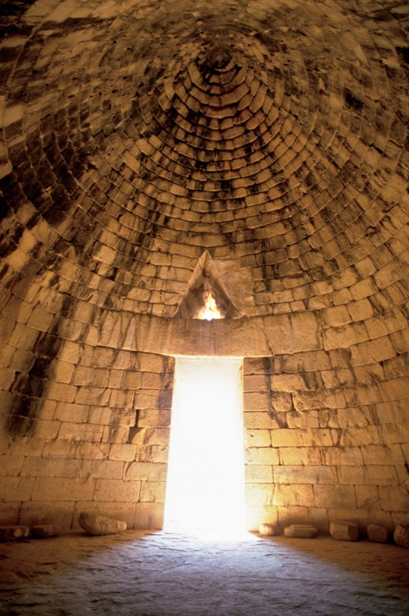
Figure 4.21
4.21 Interior of the Treasury of Atreus (looking east toward entrance), Mycenae, Greece, ca. 1300–1250 bce.

Slide 28
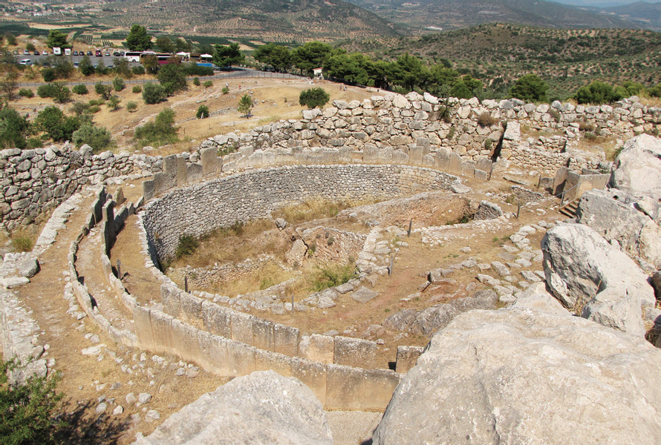
Figure 4.21A
4.21A Grave Circle A (looking southwest), Mycenae, Greece, ca. 1600 bce.

Slide 29
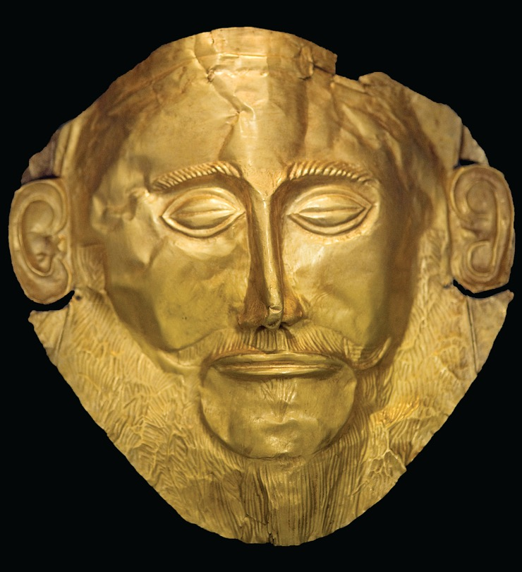
Figure 4.22
4.22 Funerary mask, from Grave Circle A (fig. 4.21A), Mycenae, Greece, ca. 1600–1500 bce. Beaten gold, 1' high. National Archaeological Museum, Athens.

Slide 30
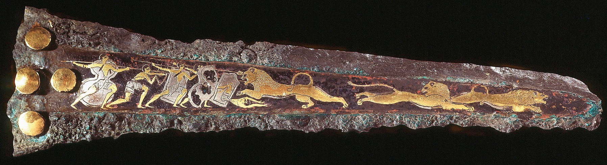
Figure 4.23
4.23 Inlaid dagger blade with lion hunt, from Grave Circle A (fig. 4.21A), Mycenae, Greece, ca. 1600–1500 bce. Bronze, inlaid with gold, silver, and niello, 9" long. National Archaeological Museum, Athens.

Slide 31
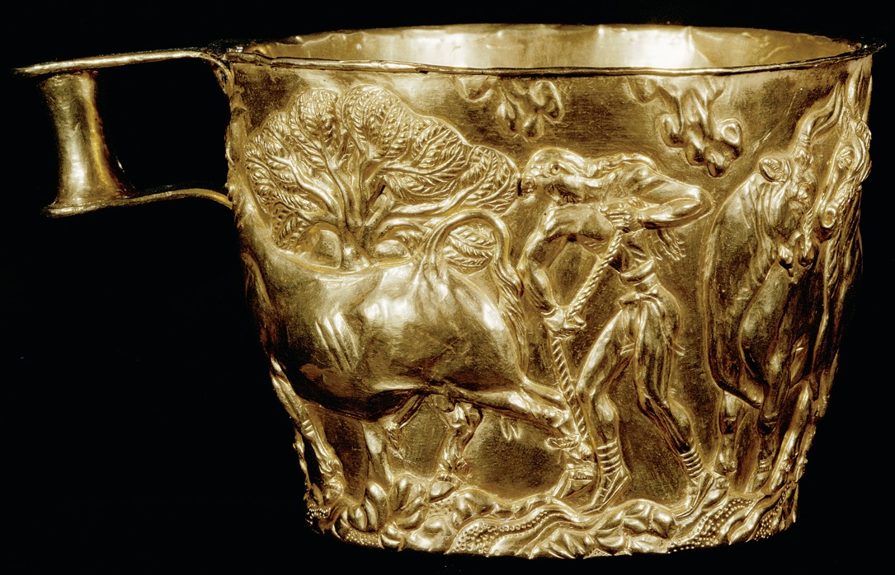
Figure 4.24
4.24 Hunter capturing a bull, drinking cup from Vapheio, near Sparta, Greece, ca. 1600–1500 bce. Gold, 3 1/2" high. National Archaeological Museum, Athens.

Slide 32
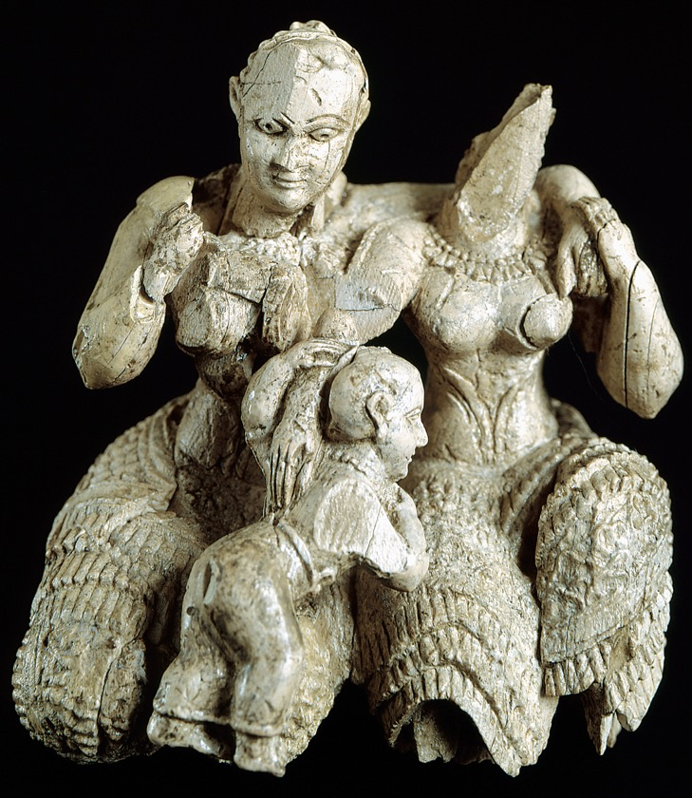
Figure 4.25
4.25 Two goddesses(?) and a child, from Mycenae, Greece, ca. 1400–1250 bce. Ivory, 2 3/4" high. National Archaeological Museum, Athens.

Slide 33
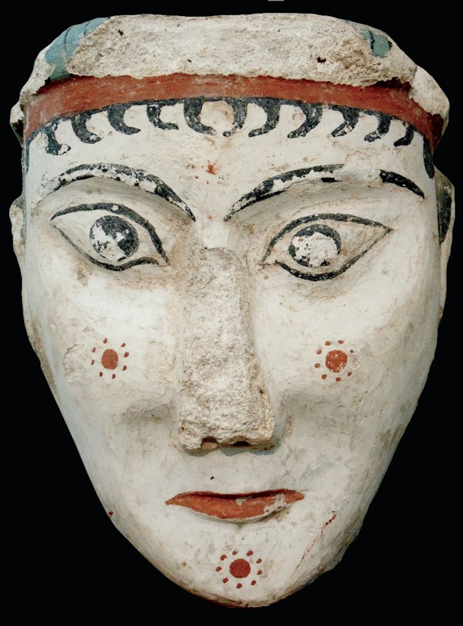
Figure 4.26
4.26 Female head, from Mycenae, Greece, ca. 1300–1250 bce. Painted plaster, 6 1/2" high. National Archaeological Museum, Athens.

Slide 34
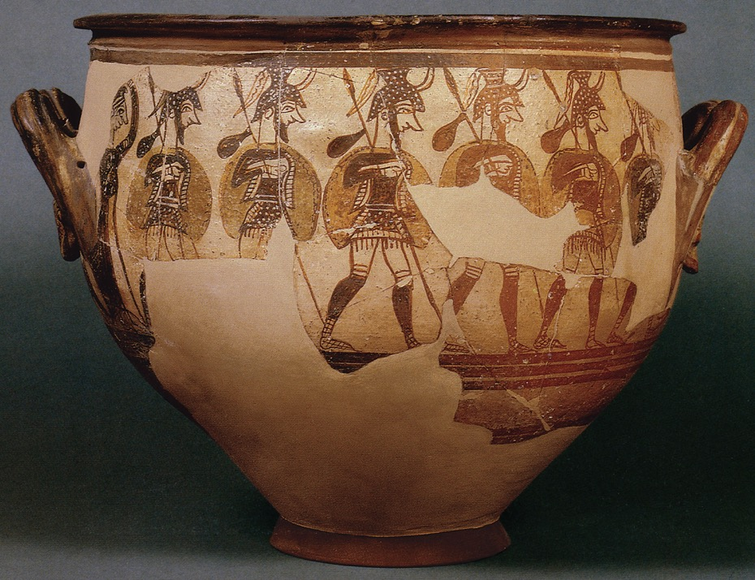
Figure 4.27
4.27 Warrior Vase (krater), from Mycenae, Greece, ca. 1200 bce. 1' 4" high. National Archaeological Museum, Athens.

Slide 35
Discussion Questions
How has the art market or illegal excavation affected our understanding of Cycladic figurines?
Compare the Egyptian New Kingdom style of wall painting with Minoan wall paintings.
How did classical literature and myths influence our perceptions of Minoan civilization?
Using the examples such as the Harvesters Vase and the Warrior Vase, compare and contrast Minoan and Mycenaean art in terms of typical subject matter and artistic style.

