Slide 1

EGYPT FROM NARMER TO CLEOPATRA
Chapter 3
Kleiner, Gardner’s Art through the Ages: A Global History, 16th Edition. © 2020 Cengage. All Rights Reserved. May not be scanned, copied or duplicated, or posted to a publicly accessible website, in whole or in part.

Slide 2
Learning Objectives
Describe the role of the Nile River in Egyptian life as well as Egyptian art and architecture.
Outline the basic tenets and divinities of the ancient Egyptian religion, especially as regards the afterlife.
Discuss the persistence of traditional forms in Egyptian art and architecture.
List differences and commonalities in Egyptian funerary and temple architecture.
Catalogue the materials used to make Egyptian statues and wall reliefs.
Explain the shift in formal and iconographic characteristics during the Amarna period of the New Kingdom.
Contrast the primary building materials of early Mesopotamian and early Egyptian architecture.
Outline the development and use of the Egyptian hieroglyphic writing system.
Identify examples of intercultural contact between Egypt and other ancient civilizations.

Slide 3
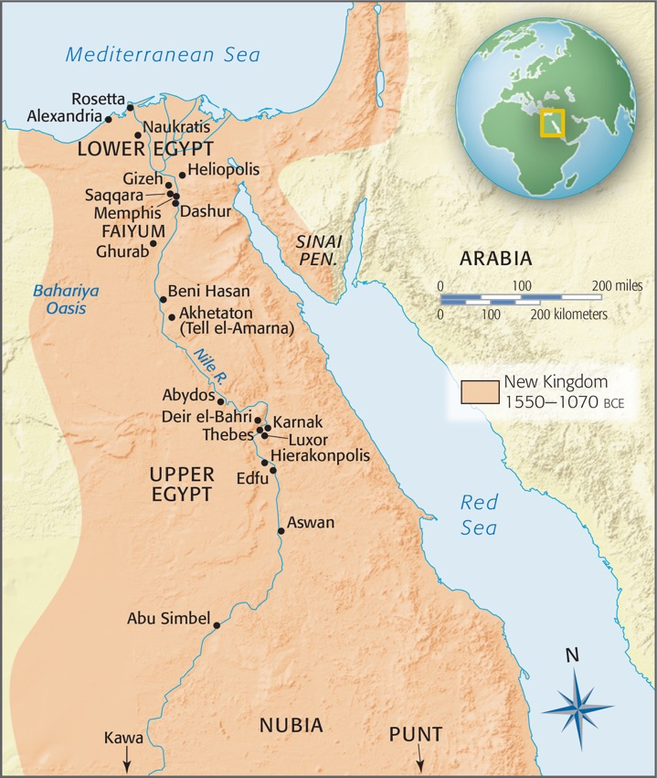
MAP 3.1
3.1 Ancient Egypt.

Slide 4
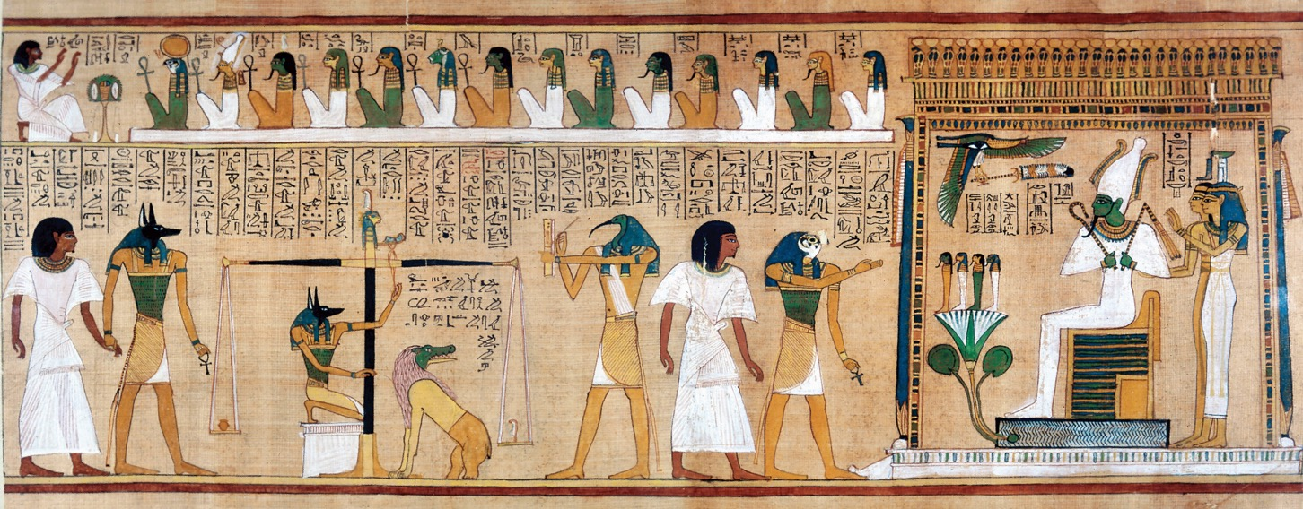
Figure 3.1
3.1 Judgment of Hunefer, detail of an illustrated Book of the Dead, from the tomb of Hunefer, Thebes, Egypt, 19th Dynasty, ca. 1290–1275 bce. Painted papyrus scroll, 1' 3 1/2" high; full scroll 18' 1/2" long. British Museum, London.

Slide 5
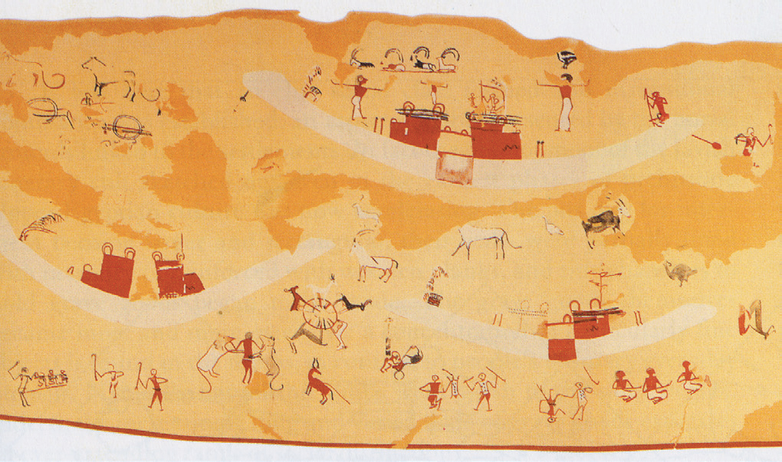
Figure 3.1A
3.1A People, boats, and animals, detail of a watercolor copy of a wall painting from tomb 100, Hierakonpolis, Egypt, Predynastic, ca. 3500–3200 bce. Paint on plaster, entire painting 16' 4" × 3' 7 3/8". Egyptian Museum, Cairo.

Slide 6
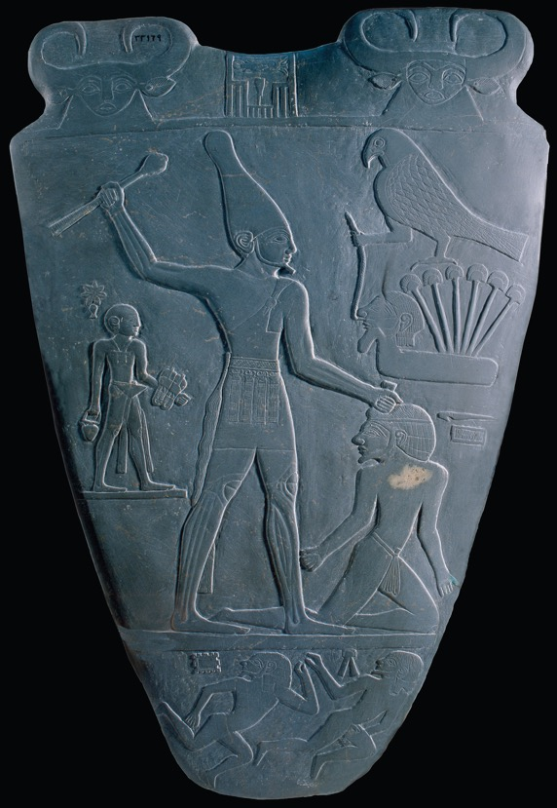
Figure 3.2
3.2 Back of the palette of King Narmer, from Hierakonpolis, Egypt, Predynastic, ca. 3000–2920 bce. Slate, 2' 1" high. Egyptian Museum, Cairo.

Slide 7
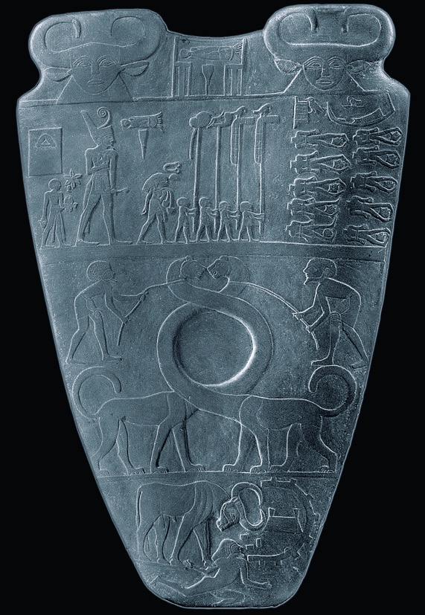
Figure 3.3
3.3 Front of the palette of King Narmer, from Hierakonpolis, Egypt, Predynastic, ca. 3000–2920 bce. Slate, 2' 1" high. Egyptian Museum, Cairo.

Slide 8
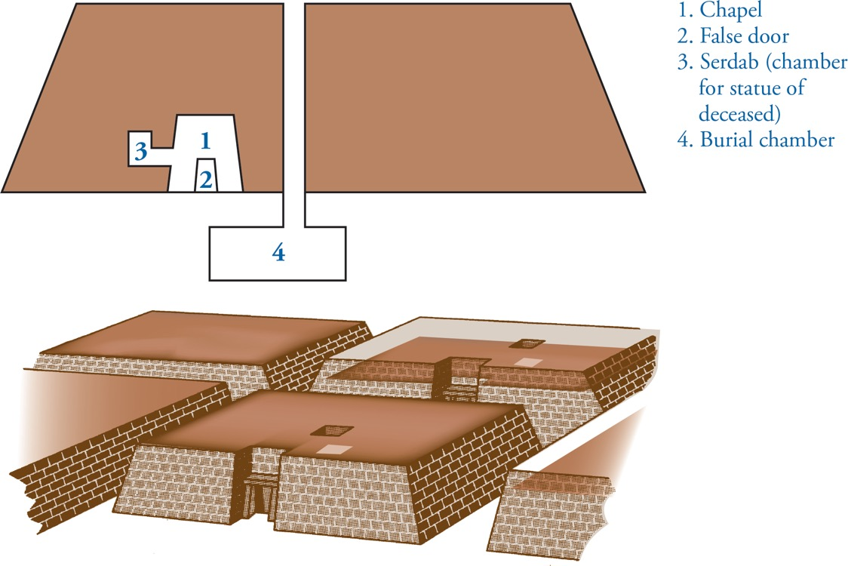
Figure 3.4
3.4 Section (top) and restored view (bottom) of typical Egyptian mastaba tombs.

Slide 9
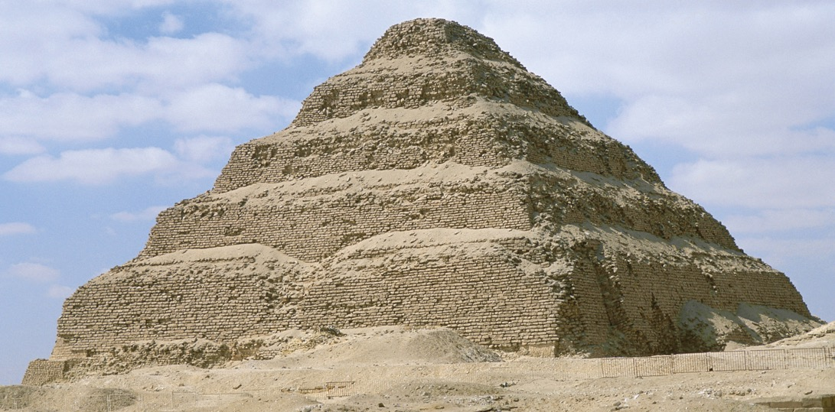
Figure 3.5
3.5 Imhotep, stepped pyramid (looking northwest) of Djoser, Saqqara, Egypt, Third Dynasty, ca. 2630–2611 bce.

Slide 10
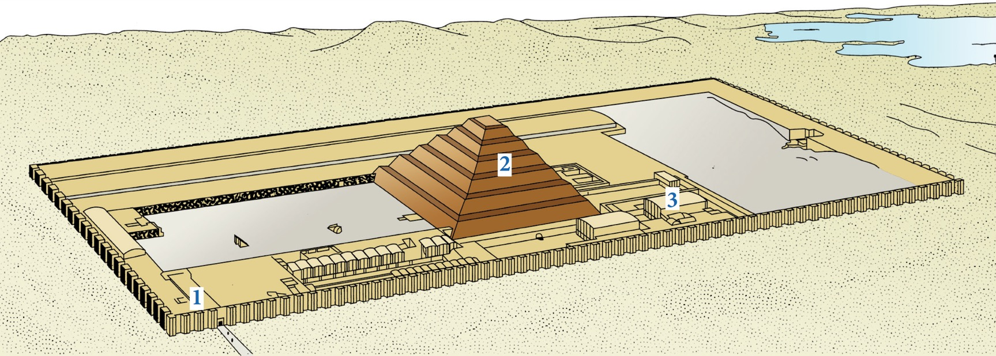
Figure 3.6
3.6 Restored view of the mortuary precinct of Djoser, Saqqara, Egypt, Third Dynasty, ca. 2630–2611 bce. (1) entrance hall, (2) stepped pyramid, (3) north palace.

Slide 11
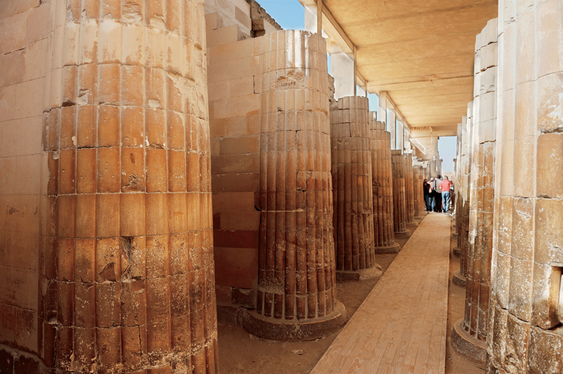
Figure 3.6A
3.6A Imhotep, columnar entrance corridor to the mortuary precinct of Djoser, Saqqara, Egypt, Third Dynasty, ca. 2630–2611 bce.

Slide 12
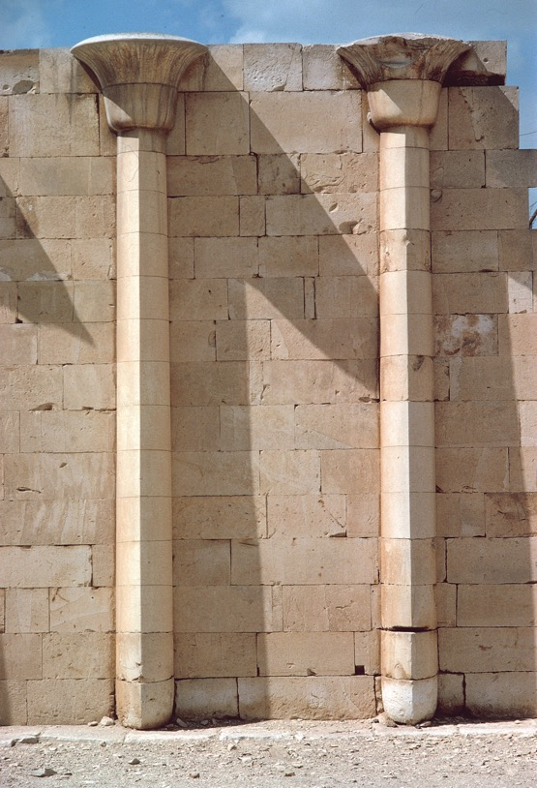
Figure 3.7
3.7 Detail of the facade of the north palace (fig. 3.6, no. 3) of the mortuary precinct of Djoser, Saqqara, Egypt, Third Dynasty, ca. 2630–2611 bce.

Slide 13
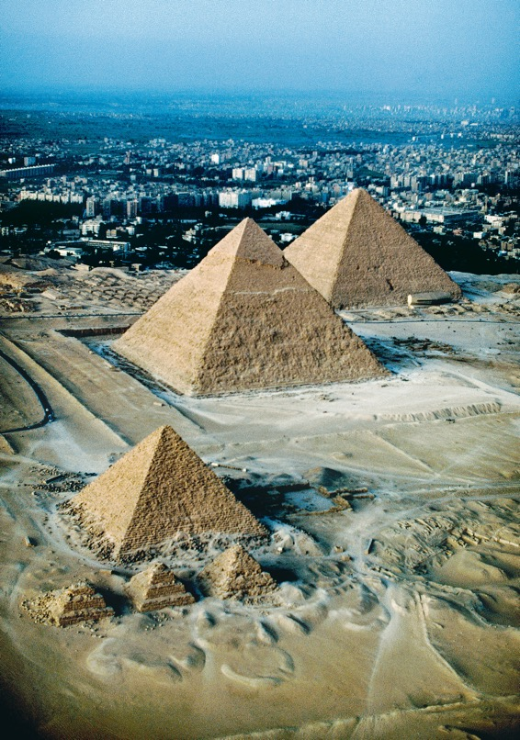
Figure 3.8
3.8 Aerial view of the Fourth Dynasty pyramids (looking north), Gizeh, Egypt. From bottom: pyramid of Menkaure, ca. 2490–2472 bce; pyramid of Khafre, ca. 2520–2494 bce; and Great Pyramid of Khufu, ca. 2551–2528 bce.

Slide 14
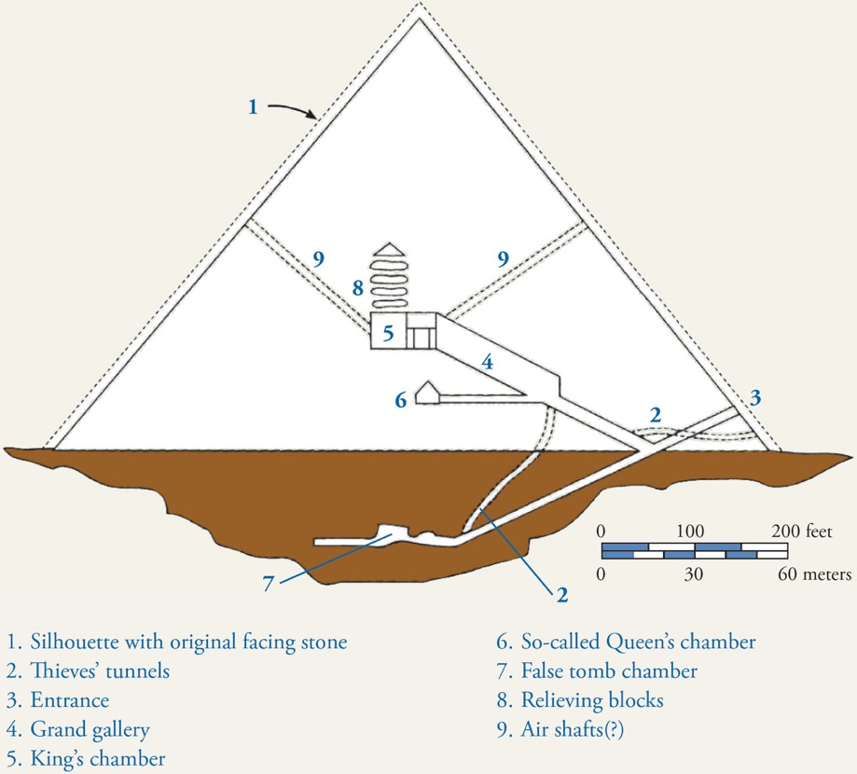
Figure 3.9
3.9 Section of the Great Pyramid of Khufu, Gizeh, Egypt, Fourth Dynasty, ca. 2551–2528 bce.

Slide 15
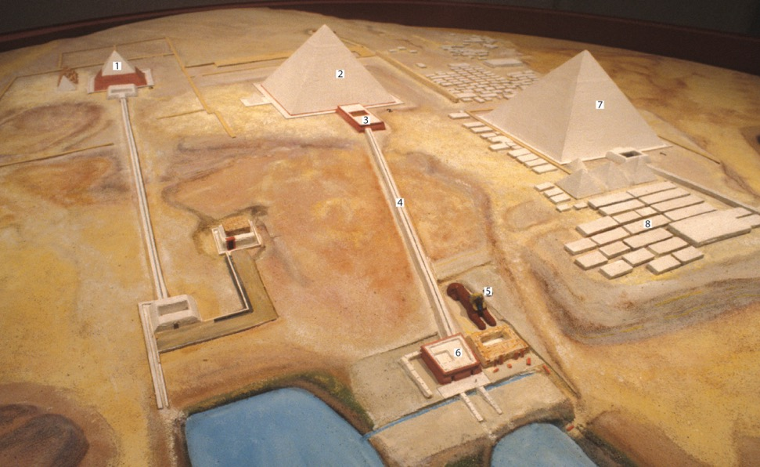
Figure 3.10
3.10 Model of the pyramid complex, Gizeh, Egypt. Harvard University Semitic Museum, Cambridge. (1) pyramid of Menkaure, (2) pyramid of Khafre, (3) mortuary temple of Khafre, (4) causeway, (5) Great Sphinx, (6) valley temple of Khafre, (7) Great Pyramid of Khufu, (8) pyramids of the royal family and mastabas of nobles.

Slide 16
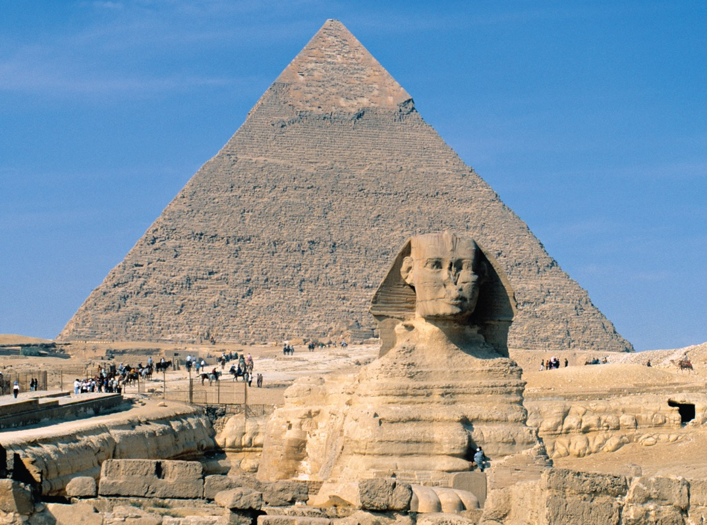
Figure 3.11
3.11 Great Sphinx (with pyramid of Khafre in the background), Gizeh, Egypt, Fourth Dynasty, ca. 2520–2494 bce. Sandstone, 65' high.

Slide 17
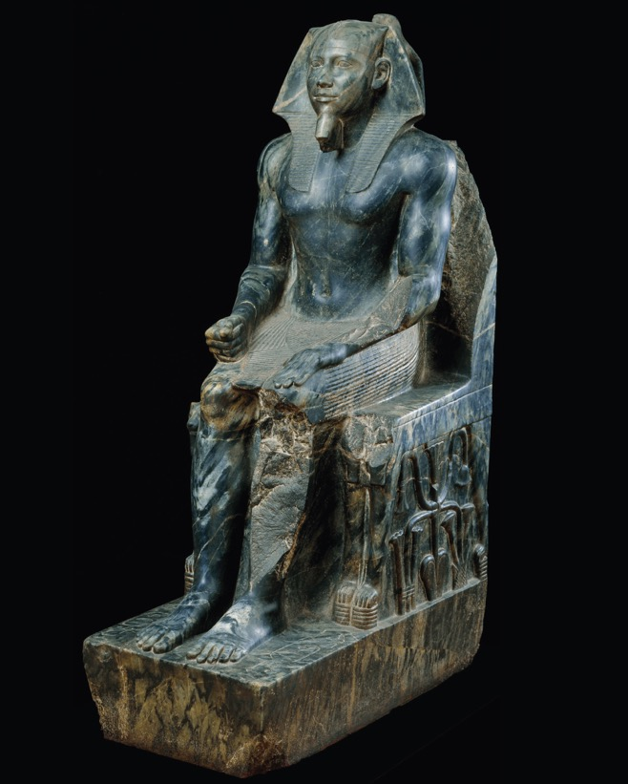
Figure 3.12
3.12 Khafre enthroned, from Gizeh, Egypt, Fourth Dynasty, ca. 2520–2494 bce. Diorite, 5' 6" high. Egyptian Museum, Cairo.

Slide 18
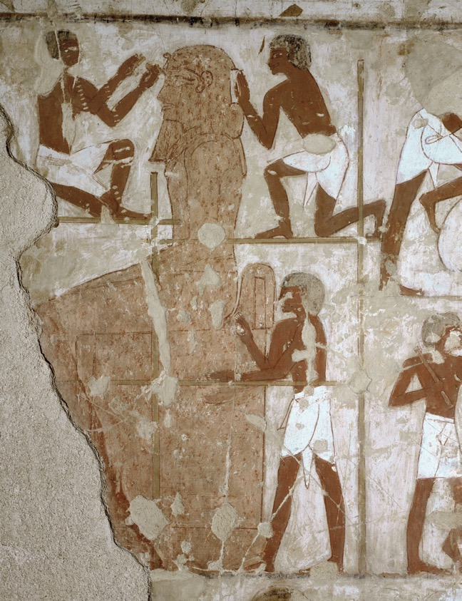
Figure 3.12A
3.12A Sculptors at work, detail of the south wall of the main hall of the funerary chapel of Rekhmire, Thebes, Egypt, 18th Dynasty, ca. 1425 bce.

Slide 19
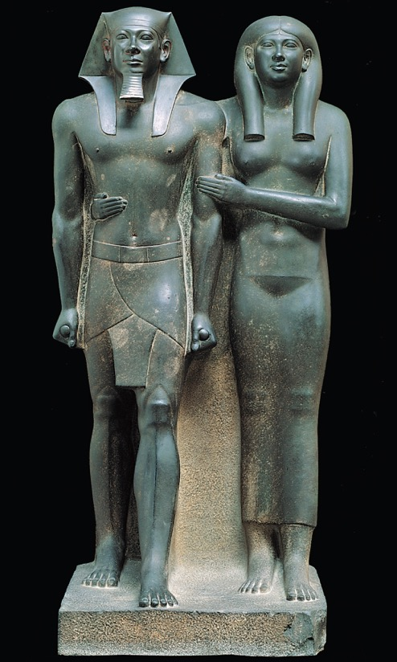
Figure 3.13
3.13 Menkaure and Khamerernebty(?), from Gizeh, Egypt, Fourth Dynasty, ca. 2490–2472 bce. Graywacke, 4‘ 6 1/2" high. Museum of Fine Arts, Boston.

Slide 20
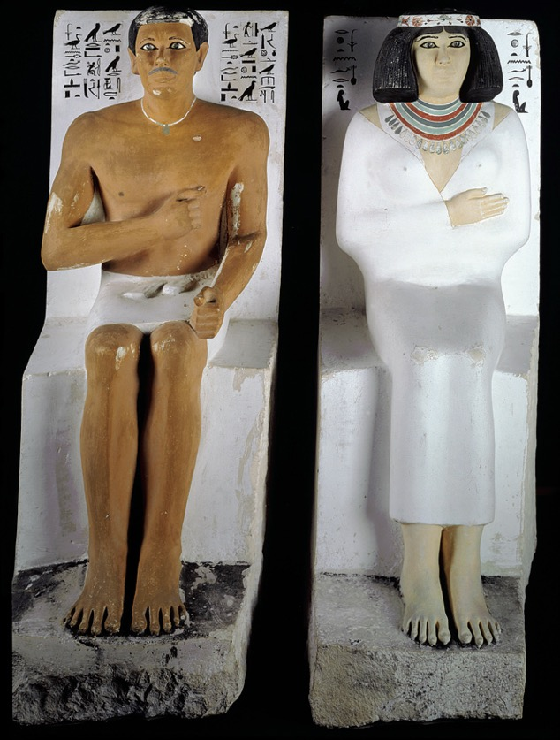
Figure 3.13A
3.13A Seated statues of Rahotep and Nofret, from their mastaba at Maidum, Egypt, Fourth Dynasty, ca. 2575–2550 bce. Painted limestone, 3' 11 5/8" and 4' high, respectively. Egyptian Museum, Cairo.

Slide 21
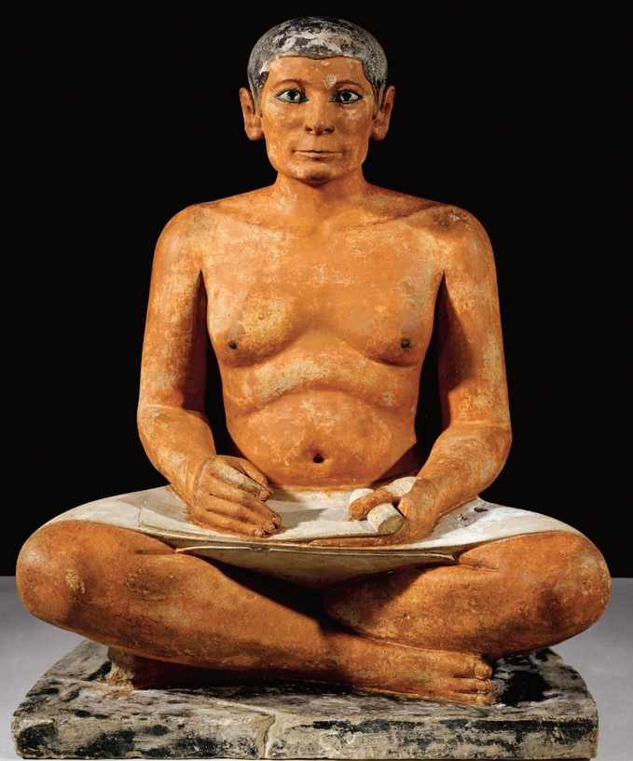
Figure 3.14
3.14 Seated scribe, from Saqqara, Egypt, Fourth Dynasty, ca. 2500 bce. Painted limestone, 1' 9" high. Musée du Louvre, Paris.

Slide 22
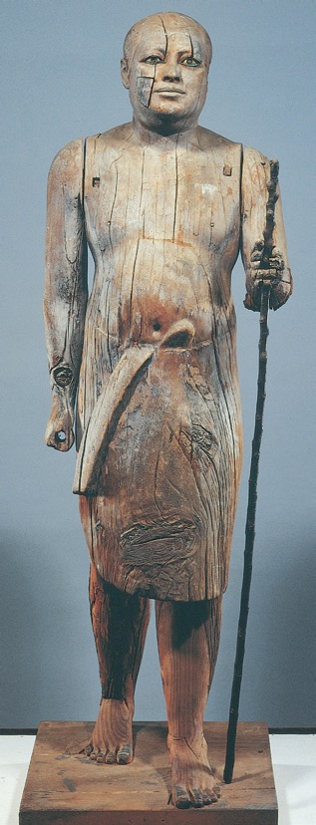
Figure 3.14A
3.14A Portrait statue of Kaaper, from his mastaba at Saqqara, Egypt, Fifth Dynasty, ca. 2450–2350 bce. Wood with rock crystal eyes, 3' 7 1/4" high. Egyptian Museum, Cairo.

Slide 23
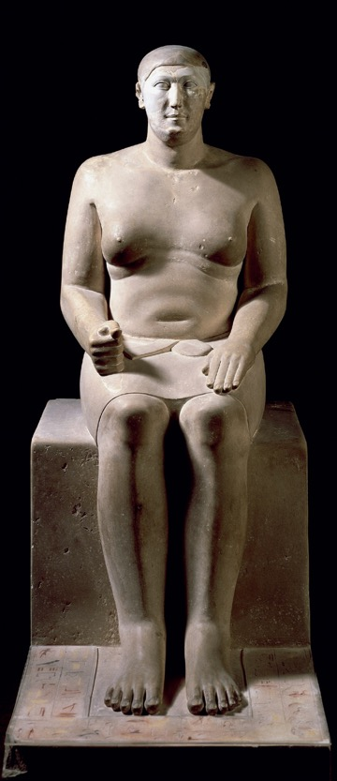
Figure 3.14B
3.14B Seated statue of Hemiunu, from his mastaba at Gizeh, Egypt, Fourth Dynasty, ca. 2550–2530 bce. Painted limestone, 5' 1 1/2" high. Römer- und Pelizaeus-Museum, Hildesheim.

Slide 24
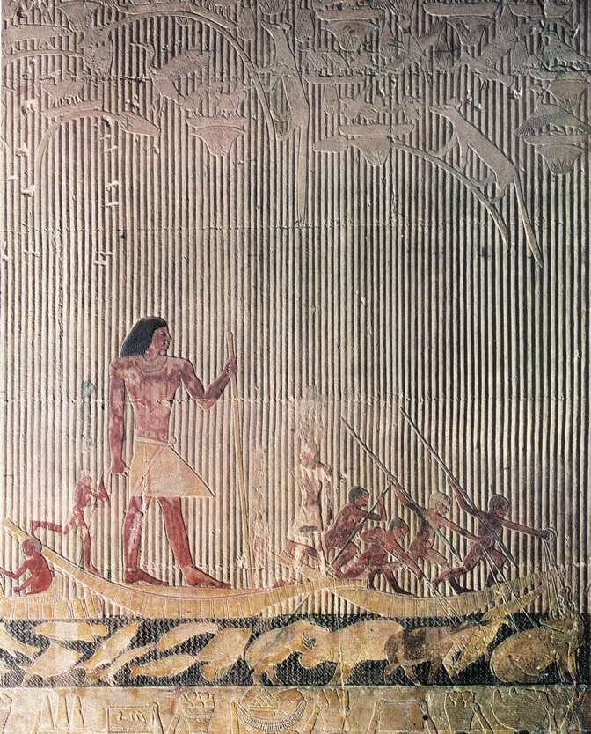
Figure 3.15
3.15 Ti watching a hippopotamus hunt, relief in the mastaba of Ti, Saqqara, Egypt, Fifth Dynasty, ca. 2450–2350 bce. Painted limestone, 4‘ high.

Slide 25
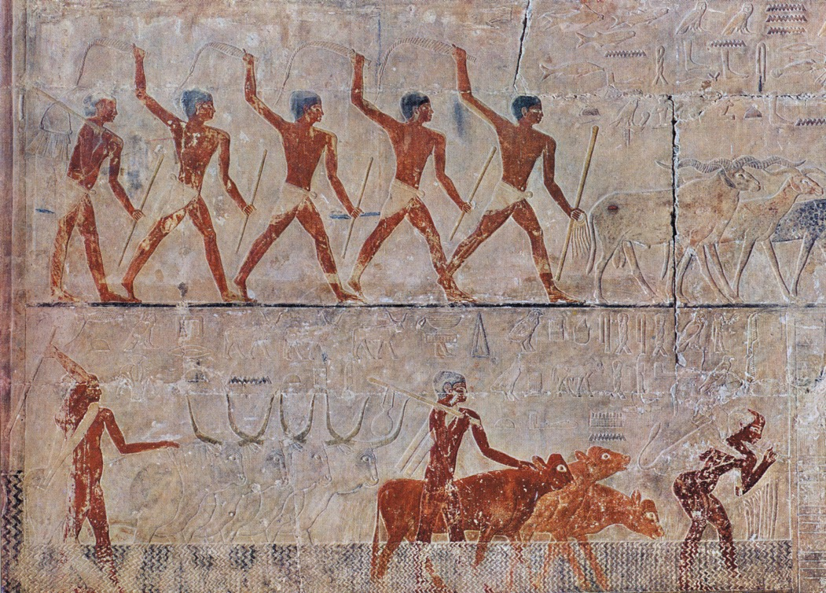
Figure 3.16
3.16 Goats treading seed and cattle fording a canal, painted limestone reliefs in the mastaba of Ti, Saqqara, Egypt, Fifth Dynasty, ca. 2450–2350 bce.

Slide 26
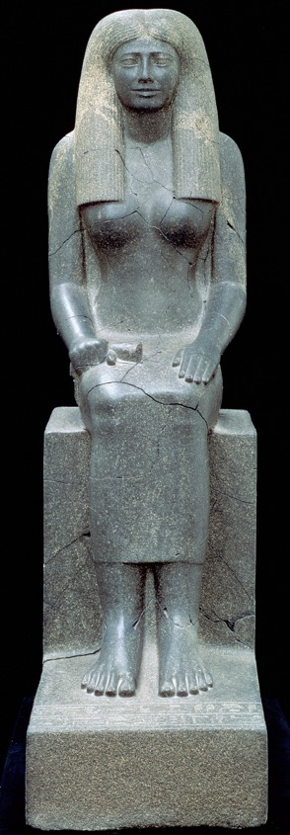
Figure 3.16A
3.16A Seated statue of Lady Sennuwy, from Kerma, Sudan, 12th Dynasty, ca. 1960–1916 bce. Diorite, 5' 7 3/4" high. Museum of Fine Arts, Boston.

Slide 27
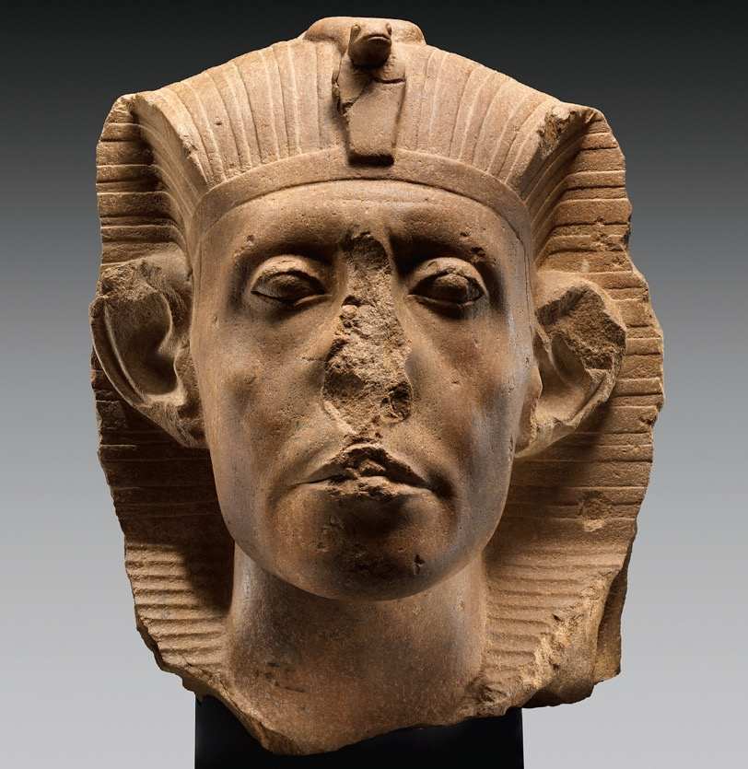
Figure 3.17
3.17 Head of Senusret III, 12th Dynasty,
ca. 1860–1850 bce. Red quartzite, 1' 5 3/4" high. Nelson-Atkins Museum of Art, Kansas City (William Rockhill Nelson Trust purchase).

Slide 28
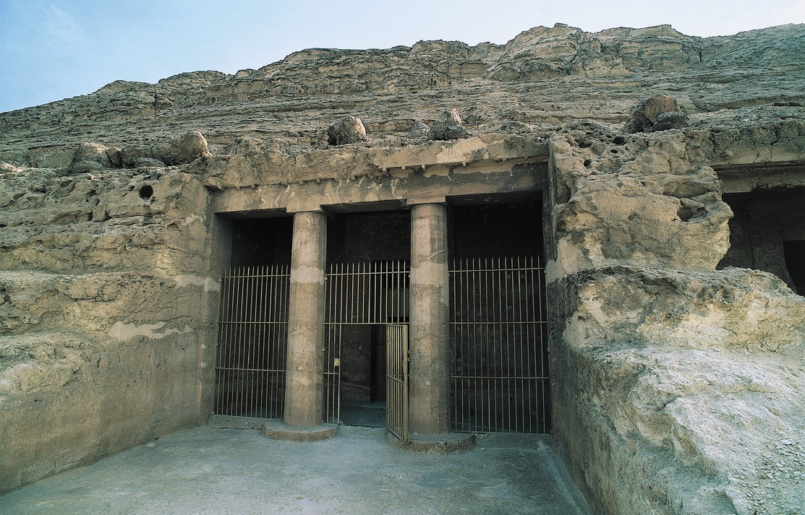
Figure 3.18
3.18 Tomb of Khnumhotep II (tomb 3), Beni Hasan, Egypt, 12th Dynasty, ca. 1900–1880 bce.

Slide 29
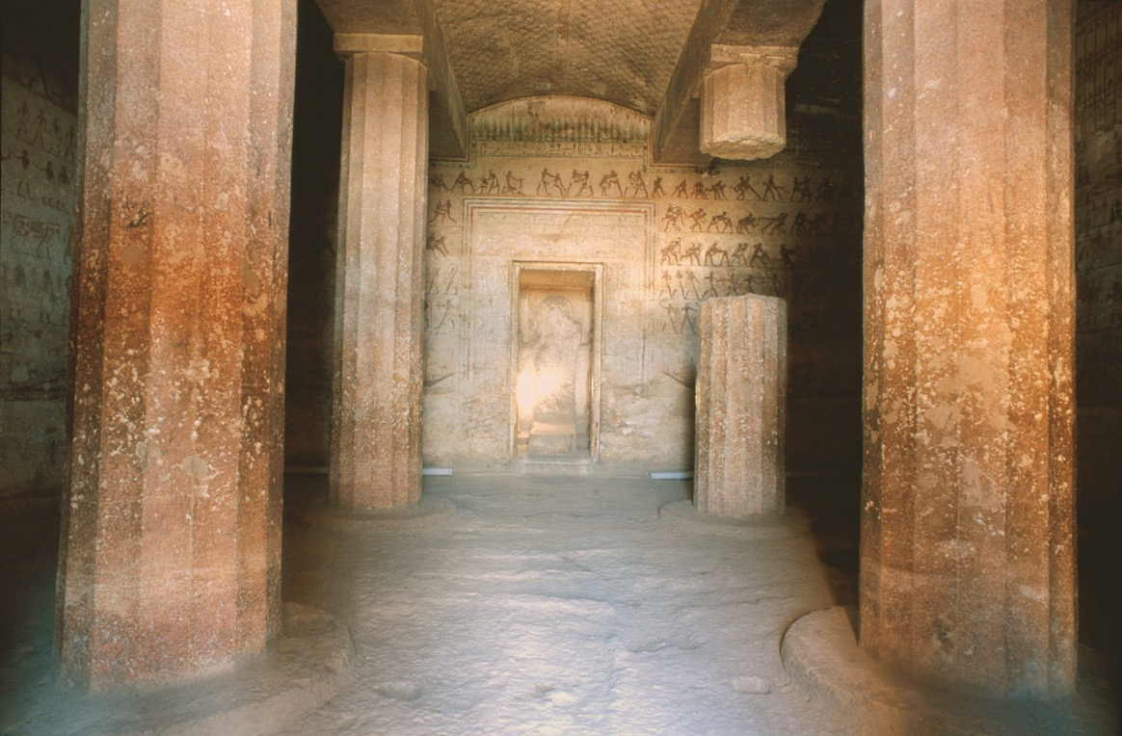
Figure 3.19
3.19 Interior hall of the rock-cut tomb of Amenemhet (tomb 2), Beni Hasan, Egypt, 12th Dynasty, ca. 1900–1880 bce.

Slide 30
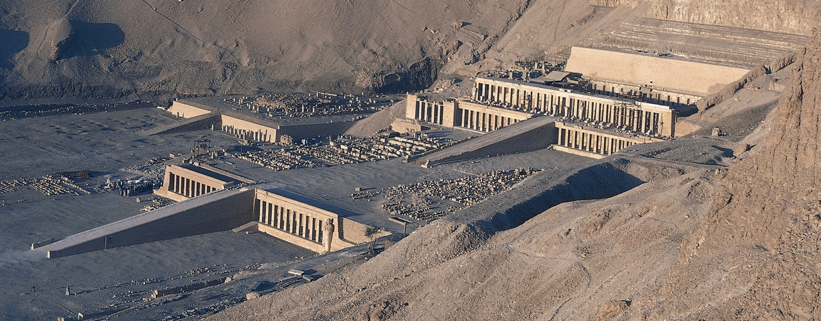
Figure 3.20
3.20 Mortuary temple of Hatshepsut (looking southwest), Deir el-Bahri, Egypt, 18th Dynasty, ca. 1473–1458 bce.

Slide 31
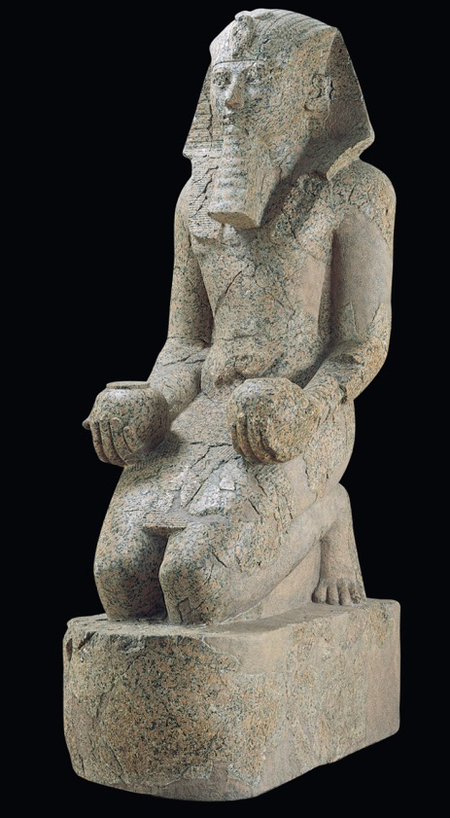
Figure 3.21
3.21 Hatshepsut with offering jars, from the upper court of her mortuary temple, Deir el-Bahri, Egypt, 18th Dynasty, ca. 1473–1458 bce. Red granite, 8' 6" high. Metropolitan Museum of Art, New York.

Slide 32
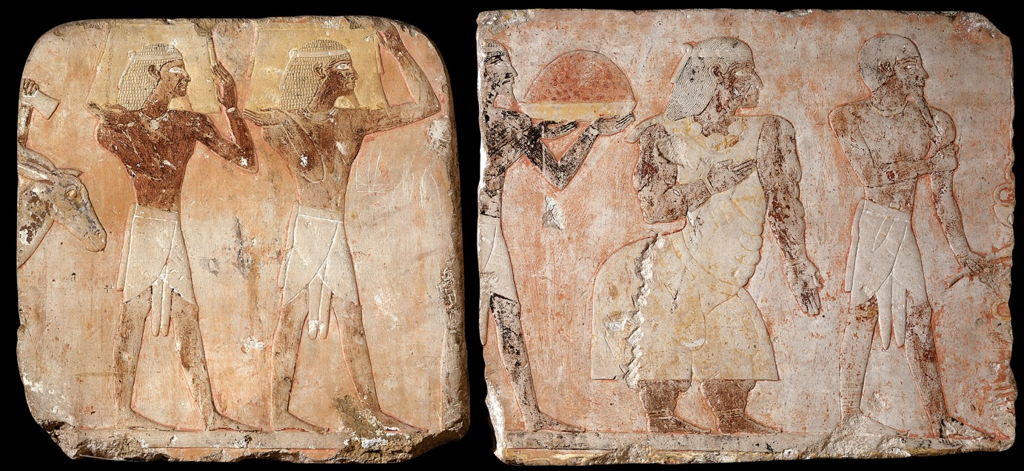
Figure 3.22
3.22 King and queen of Punt and attendants, relief from the mortuary temple of Hatshepsut, Deir el-Bahri, Egypt, 18th Dynasty, ca. 1473–1458 bce. Painted limestone, 1' 3" high. Egyptian Museum, Cairo.

Slide 33
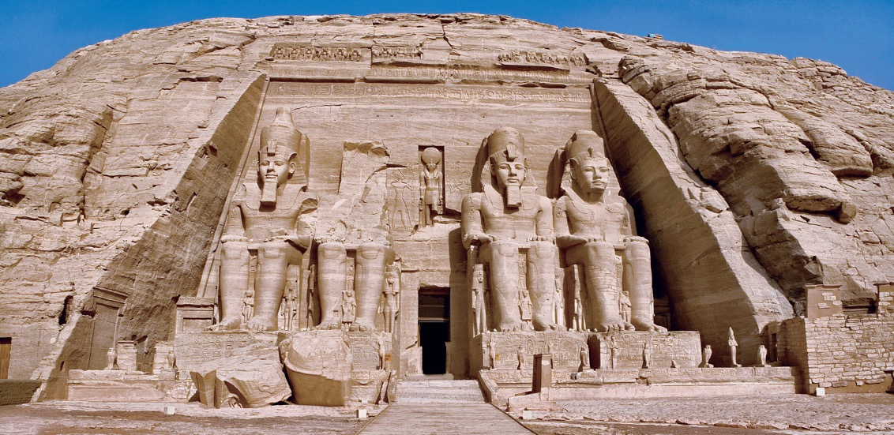
Figure 3.23
3.23 Facade of the temple of Ramses II, Abu Simbel, Egypt, 19th Dynasty, ca. 1290–1224 bce. Sandstone, colossi 65' high.

Slide 34
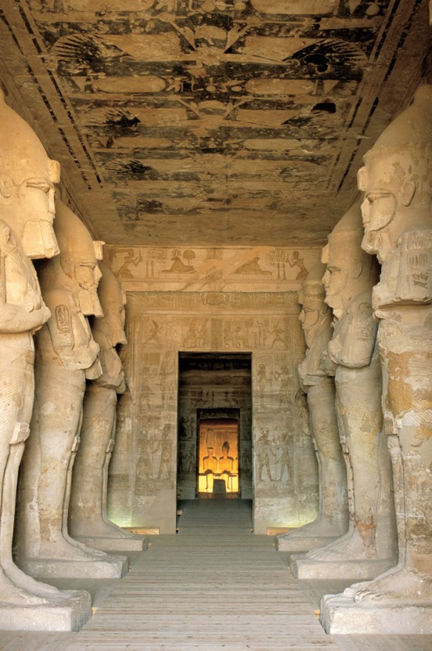
Figure 3.23A
3.23A Interior of the temple of Ramses II, Abu Simbel, Egypt, 19th Dynasty, ca. 1290–1224 bce. Sandstone, pillar statues 32' high.

Slide 35
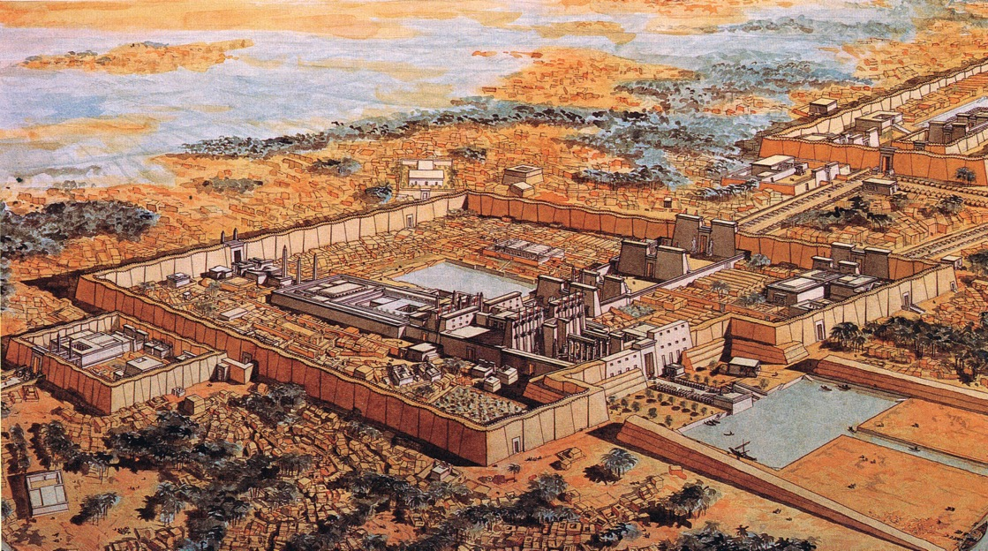
Figure 3.24
3.24 Restored view of the temple of Amen-Re (looking southeast), Karnak, Egypt, major construction 15th–13th centuries bce (Jean Claude Golvin).

Slide 36
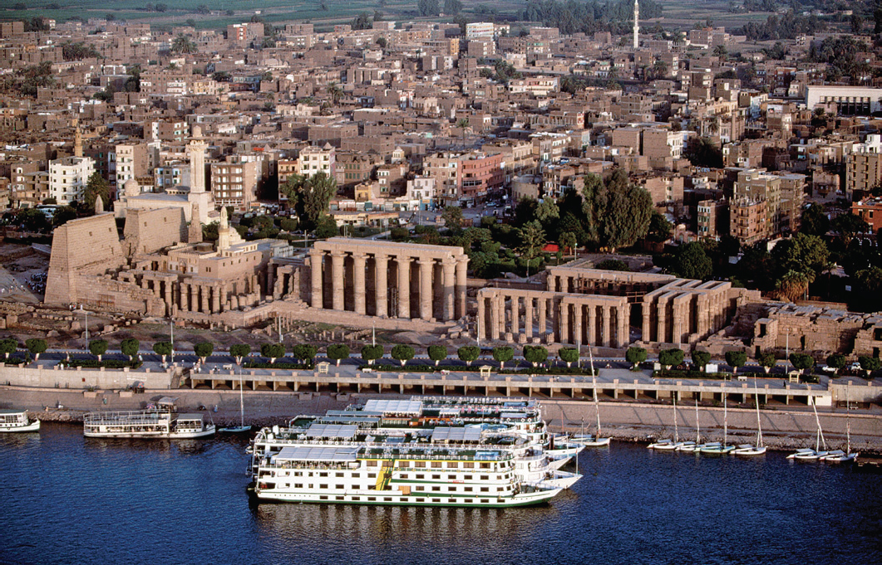
Figure 3.24A
3.24A Aerial view of the temple of Amen-Re, Mut, and Khonsu (looking east), Luxor, Egypt, 18th and 19th Dynasties, begun early 14th century bce.

Slide 37
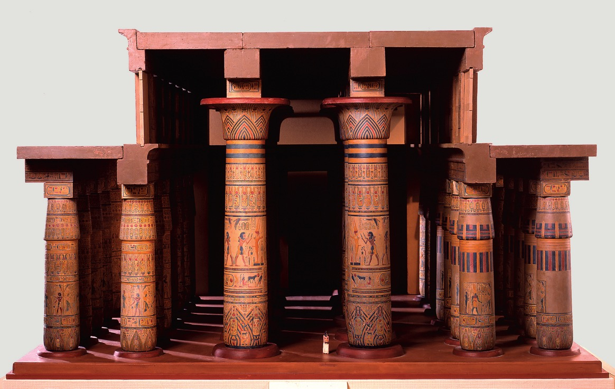
Figure 3.25
3.25 Model of the hypostyle hall, temple of Amen-Re, Karnak, Egypt, 19th Dynasty, ca. 1290–1224 bce. Metropolitan Museum of Art, New York.

Slide 38
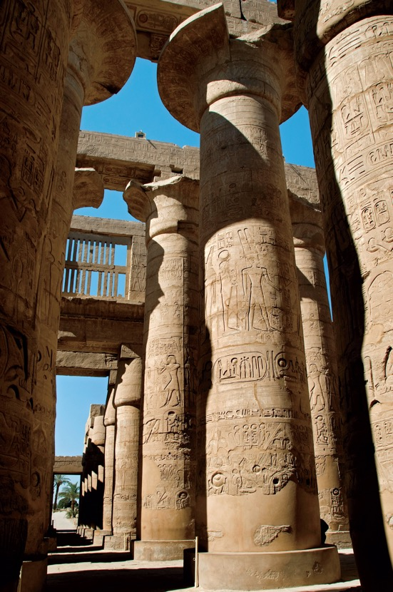
Figure 3.26
3.26 Columns and clerestory of the hypostyle hall of the temple of Amen-Re, Karnak, Egypt, 19th Dynasty, ca. 1290–1224 bce.

Slide 39
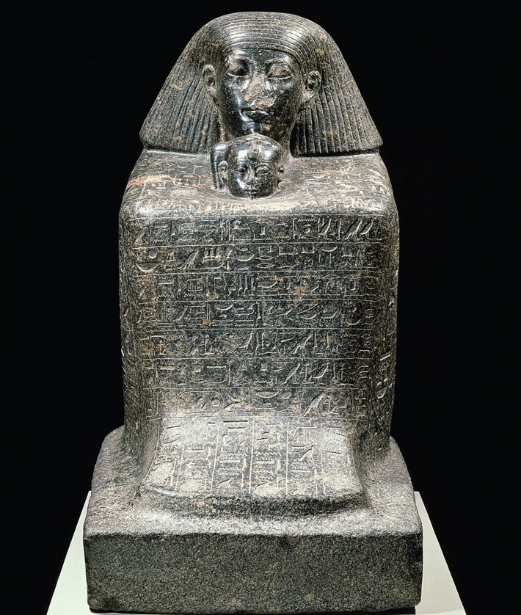
Figure 3.27
3.27 Senenmut with Princess Nefrura, from Thebes, Egypt, 18th Dynasty, ca. 1470–1460 bce. Granite, 3' 1/2" high. Ägyptisches Museum, Staatliche Museen zu Berlin, Berlin.

Slide 40
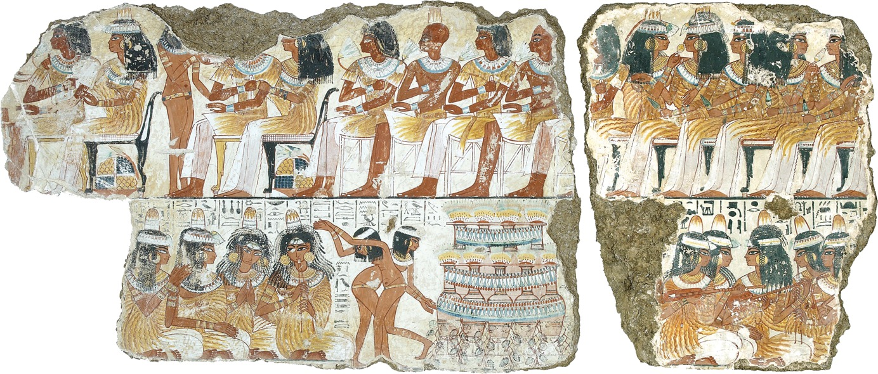
Figure 3.28
3.28 Musicians and dancers, detail of a mural from the tomb of Nebamun, Thebes, Egypt, 18th Dynasty, ca. 1400–1350 bce. Fresco secco, 1' × 2' 3". British Museum, London.

Slide 41
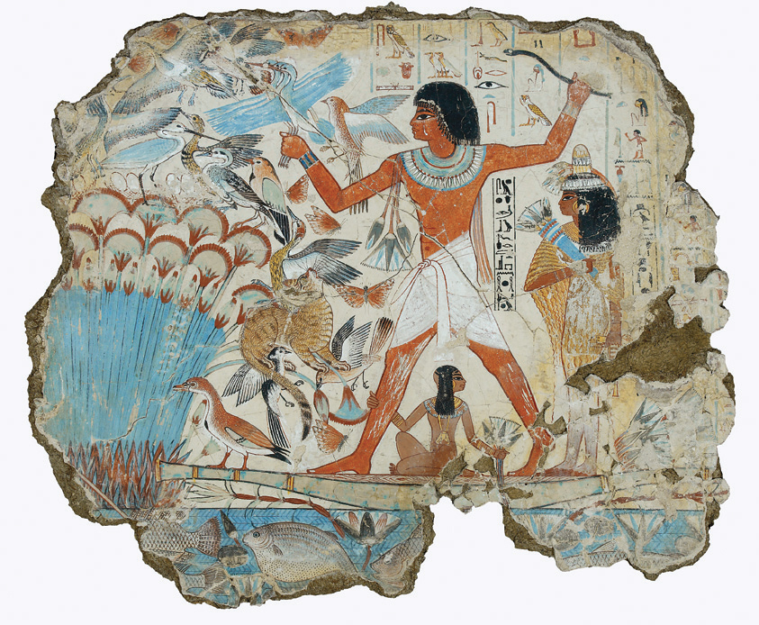
Figure 3.28A
3.28A Fowling scene, from the tomb of Nebamun, Thebes, Egypt, 18th Dynasty, ca. 1400–1350 bce. Fresco secco, 2' 8" high. British Museum, London.

Slide 42
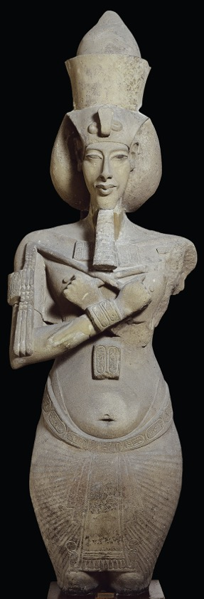
Figure 3.29
3.29 Akhenaton, colossal statue from the temple of Aton, Karnak, Egypt, 18th Dynasty, ca. 1353–1335 bce. Sandstone, 13' high. Egyptian Museum, Cairo.

Slide 43
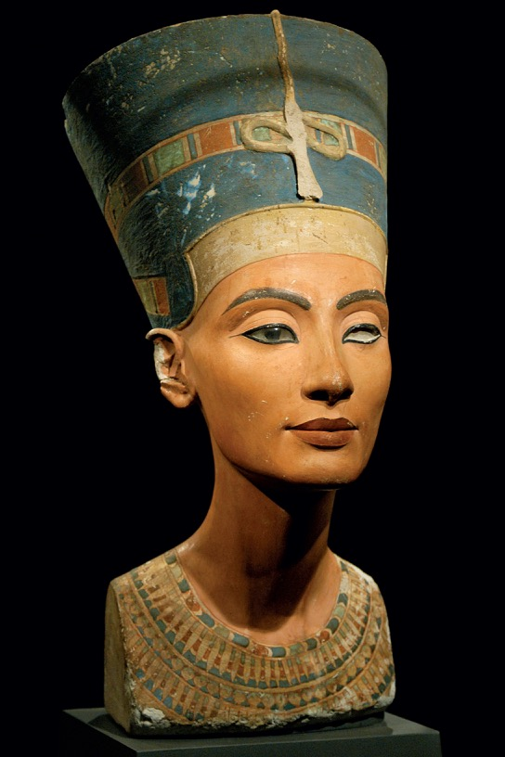
Figure 3.30
3.30 Thutmose, bust of Nefertiti, from Amarna, Egypt, 18th Dynasty, ca. 1353–1335 bce. Painted limestone, 1' 8" high. Ägyptisches Museum, Staatliche Museen zu Berlin, Berlin.

Slide 44
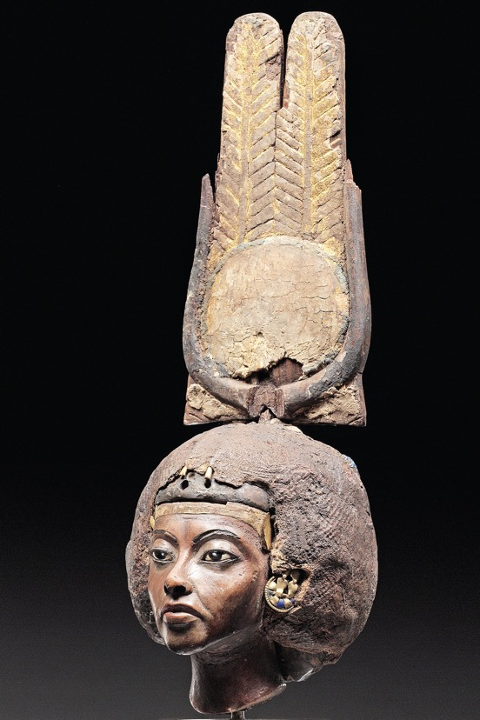
Figure 3.31
3.31 Portrait of Tiye, from Ghurab, Egypt, 18th Dynasty, ca. 1353–1335 bce. Yew wood, gold, silver, alabaster, faience, and lapis lazuli, 8 7/8" high. Ägyptisches Museum, Staatliche Museen zu Berlin, Berlin.

Slide 45
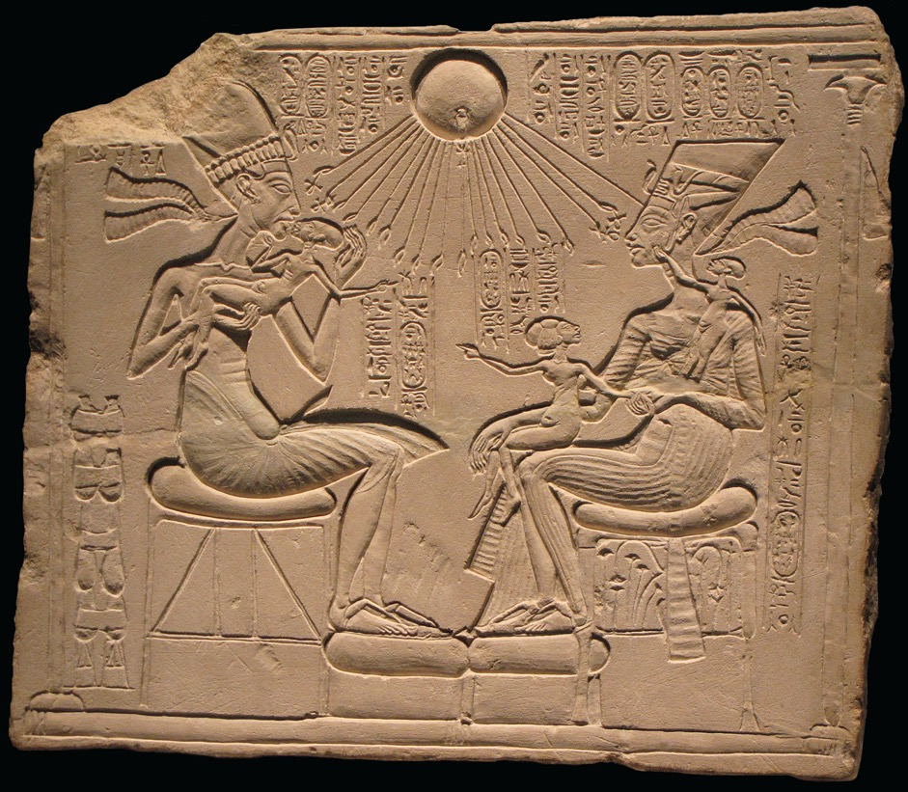
Figure 3.32
3.32 Akhenaton and Nefertiti with three daughters, from Amarna, Egypt, 18th Dynasty, ca. 1353–1335 bce. Limestone, 1' 1/4" high. Ägyptisches Museum, Staatliche Museen zu Berlin, Berlin.

Slide 46
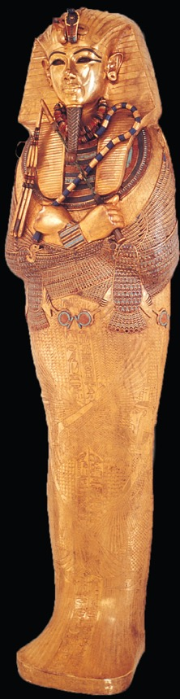
Figure 3.33
3.33 Innermost coffin of Tutankhamen, from his tomb at Thebes, Egypt, 18th Dynasty, ca. 1323 bce. Gold with inlay of enamel and semiprecious stones,
6' 1" long. Egyptian Museum, Cairo.

Slide 47
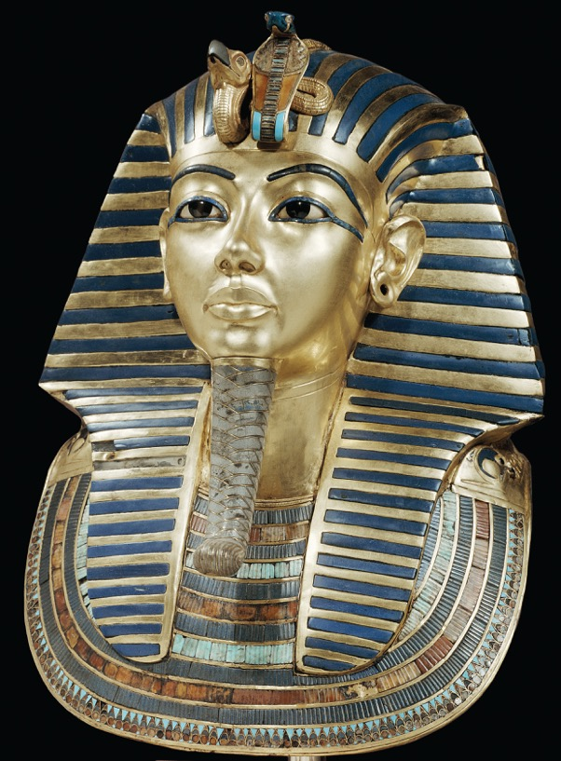
Figure 3.34
3.34 Death mask of Tutankhamen, from the innermost coffin in his tomb at Thebes, Egypt, 18th Dynasty, ca. 1323 bce. Gold with inlay of semiprecious stones, 1' 9 1/4" high. Egyptian Museum, Cairo.

Slide 48
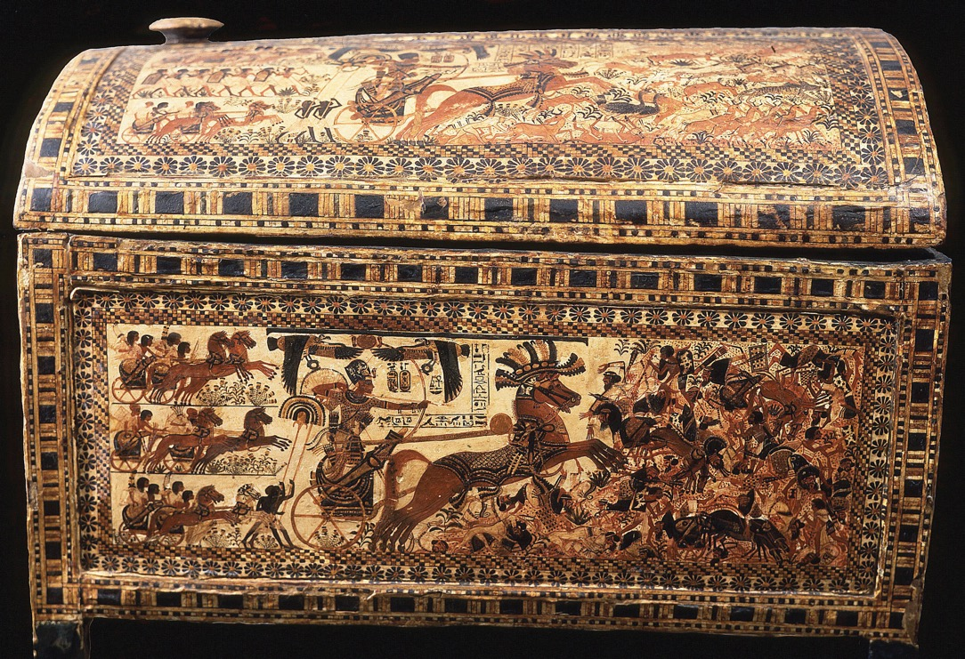
Figure 3.35
3.35 Painted chest, from the tomb of Tutankhamen, Thebes, Egypt, 18th Dynasty, ca. 1333–1323 bce. Wood, 1' 8" long. Egyptian Museum, Cairo.

Slide 49
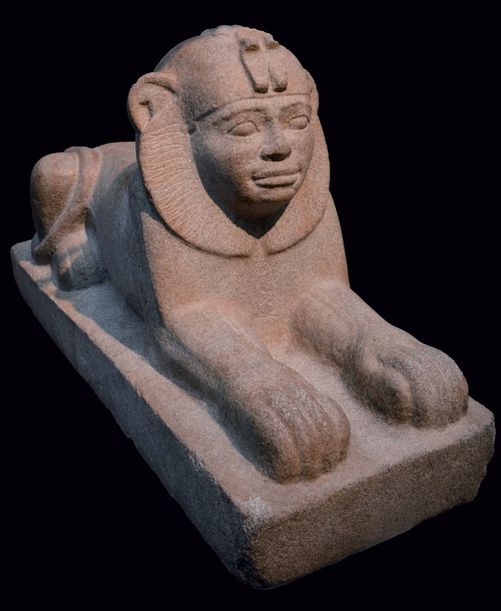
Figure 3.36
3.36 Taharqo as a sphinx, from temple T, Kawa, Sudan, 25th Dynasty, ca. 680 bce. Granite, 1' 4" × 2' 4 3/4". British Museum, London.

Slide 50
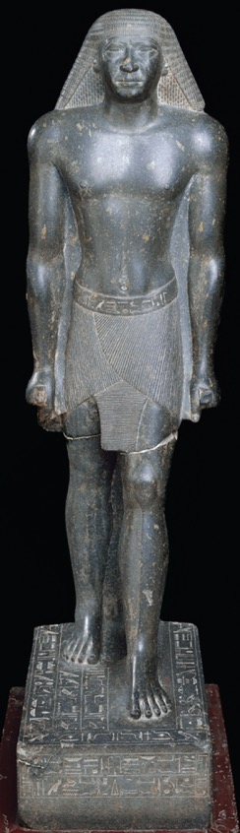
Figure 3.37
3.37 Portrait statue of Mentuemhet, from Karnak, Egypt, 26th Dynasty, ca. 660–650 bce. Granite, 4' 5" high. Egyptian Museum, Cairo.

Slide 51
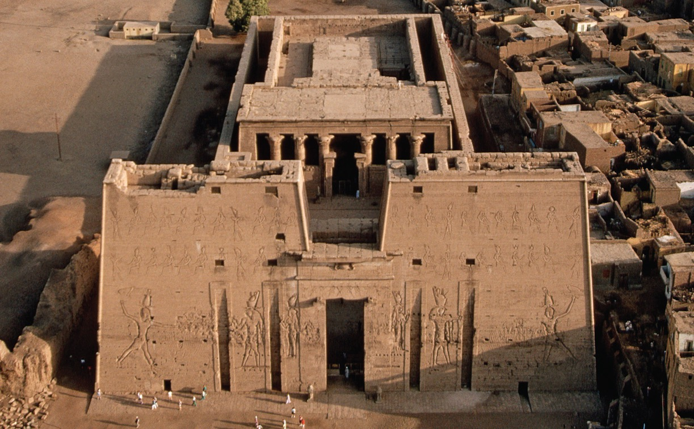
Figure 3.38
3.38 Temple of Horus (looking east), Edfu, Egypt, ca. 237–47 bce.

Slide 52
Discussion Questions
How do you speculate the Great Pyramid was built? What would have been some specific problems that its builders had to consider?
What are the main differences between Old Kingdom pyramids and New Kingdom mortuary temples?
What is an example of how a change in religion brought about a change in art in ancient Egypt?
How did the female pharaoh Hatshepsut both continue and modify the traditions of rendering pharaohs?

